Slide 1

Altmetrics Applied Fiesole 2013
Jennifer Lin
Sr Product Manager, PLOS
Notes:
With the exploding volume of content made freely available through OA, the newest challenge in OA publishing is the evaluation of content for discovery, organization and assessment. The digital environment of today’s research enables the collection and analysis of many more data sources and types than ever before which trace the dissemination and reach of the article itself. Article-level metrics (ALMs) measure these activities at the level of the article and provide a valuable service lacking in traditional metrics: a real-time indicator of impact for research. In addition to the conventional measure of citations, ALMs incorporate altmetrics, newer measures of scholarly interaction based on the social web. Overall, they can provide much-needed new checks and balances, greater speed of feedback and superior relationship mapping and influence tracking, none of which can be replicated by the traditional impact factor. They can form the basis of recommendation and collaborative filtering systems able to power navigation and discovery of articles synchronized to the needs of the researcher, publisher, institutional decision-maker or funder. ALMs also offer new ways for measuring and evaluating research quality and impact in administrative decision-making (e.g., hiring, tenure, funding, etc.)
It’s the “end of the beginning” as John Wilbanks has noted. NEXT FRONTIER.
Ensure full reuse rights. Get the Rights Right.
Cultural shift for researcher publishing and sharing practices. (IF)

Slide 2
PLOS: Brief History
Founded in 2003 as an open access publisher, Public Library of Science
Seven journals today in life sciences & biomedical science
Published 80k+ articles to date
Mission: transform scholarly communications

Slide 3
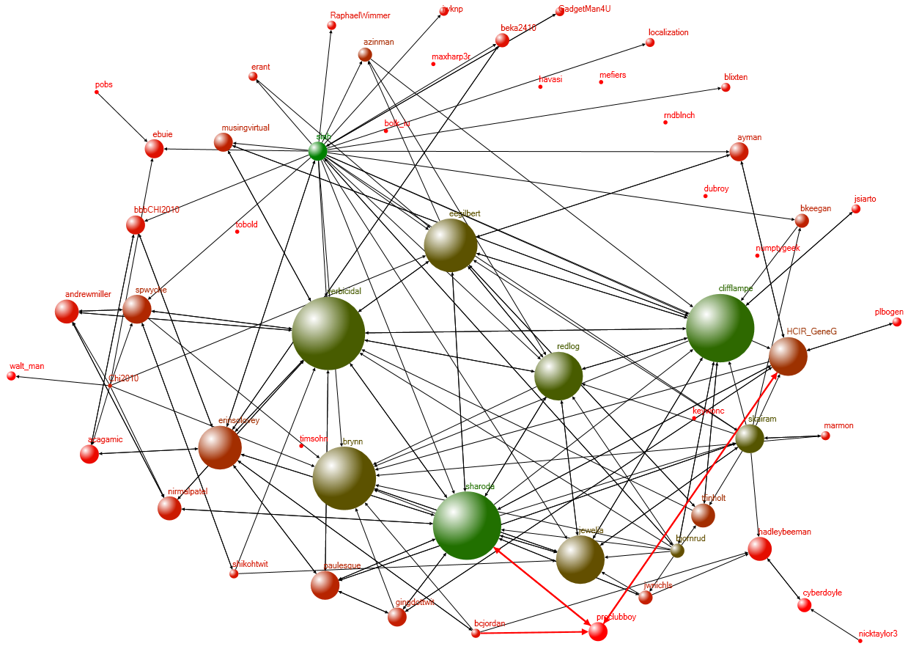
Networked-enabled research is premised on the capacity for connectivity
See Cameron Neylon’s Feb 6, 2012 blog post on “network-enabled research”: http://cameronneylon.net/blog/network-enabled-research/.

Slide 4
PLOS: Optimize network-enabled research by building infrastructure that supports more efficient transactions
Over the past ten years:
Open access for all
Re-defined publication criteria & categorization
Tracking and measurement of dissemination
Article-Level Metrics

Slide 5

The Measurement Dilemma
Notes:
The measurement dilemma: How do we best measure the size of a barrel?
The number of monkeys?
The width and girth by meters or feet?
The cans of varnish to paint the barrel?
The pounds of bananas that the monkeys eat in it?
And what happens where there isn’t one barrel we have to measure, but hundreds of thousands that appear each year?
I have published an article and published it in PLOS Genetics. What is its influence and reach?
This paper is one amongst 70k papers JUST in the PLOS corpus alone. How do I measure it?
Known, widely discussed problems in the face of large, undifferentiated mounds of data and results:
• Journal brand bias: Worthiness of attention and relevance to type of problem/field of interest is encoded for practical purposes by journal name. Research articles are not currently primarily judged on their individual merits, but rather on the basis of the journal in which they happen to be published. This approach distorts assessment not only for the accurate assignment of credit to the researcher(s) involved, but also for the broader research process for the entire scientific community.
Altogether, the journal title as a proxy for quality just does not work effectively in getting researchers reliable and valuable information to them.
• Citations alone #FAIL: context-free, easily gamed, encourages undesirable strategic behavior by researchers

Slide 6
Researchers work within a diverse ecosystem of channels to share, comment, critique new research:
Measurement of research
article access,
scholarly and nonscholarly citations,
blog and news coverage,
social network sharing
research community conversations
ALMs
Article-Level Metrics captures this activity and measures it in a transparent and comprehensive manner.
Notes:
Mark Morvant – analytics of chemistry course podcast lectures
Another example of how metrics for tenure and promotion can change

Slide 7
Conventional measures are a part of the puzzle…

Slide 8
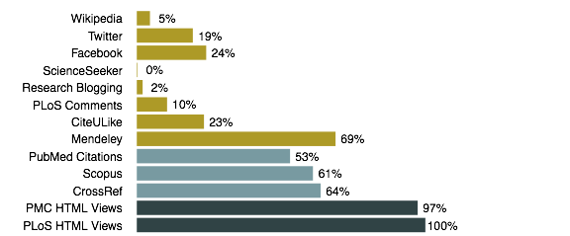
A broader view of research engagement
Proportion of articles covered by source
Metrics for 77,385 PLOS articles. Data collected April 11, 2013

Slide 9
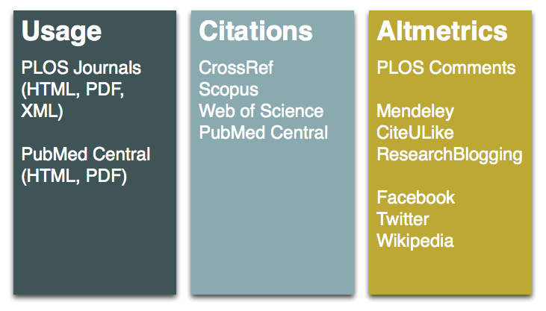

Article-level metrics add granularity and more dimensions
F1000 Prime
9

Slide 10
Article-Level Metrics:
Diverse and efficient measurement
Increased diversity without losing traditional value
Accelerated measurement response
Flexibly accommodates varied uses
Notes:
Benefits of ALMs.
The last point is the one which we are concerned with today in this session.

Slide 11
ALMs reveal what articles are used
Doris Duke Foundation funded PLOS articles
Rectangle size correlates with total views (HTML and PDF) from PLOS website. Color intensity correlates with number of Scopus citations.
Article Usage and Citations by Subject Category
Notes:
Very basic: if people cannot trust the data, they will not use it.
All the powerful benefits to ALMs – transforming research impact assessment, research discovery and navigation of literature, etc. None of this is possible if we do not have a robust system that ensures data integrity, one which is not just comprised of machine monitoring but human guardianship as well as community norms.

Slide 12
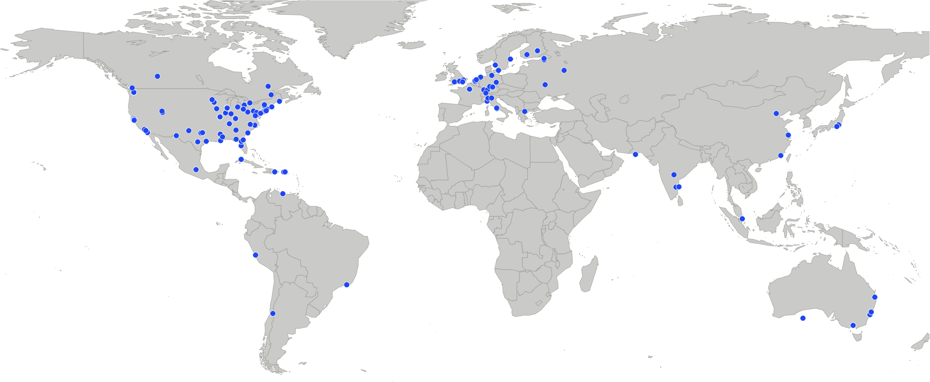
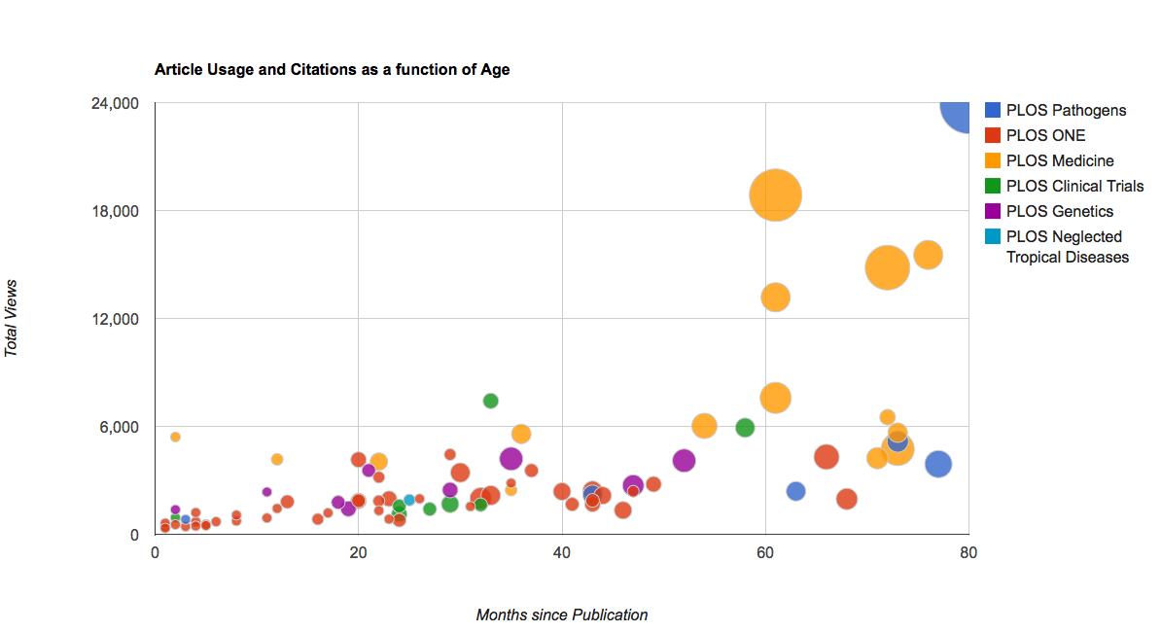
ALMs reveal where articles are used
Alzheimer‘s Association funded PLOS articles
Geolocation of 410 authors for 84 articles
ALMs reveal how is used
Notes:
ALMs can also be used to show where articles are used. This graph geolocates authors of articles. But the same geolocation can be show for Tweets.

Slide 13
Altmetrics Applied - PLOS Journals
Notes:
Article: Quick display of metrics on article page: relative metrics, new classifications, metrics tab redesign, new ALMs, more data visualization (default graphs)
Search: Search page: sort, search, filter on any ALM data: date range, tags, Journal, Author, Event Type for any ALM attribute
Search based upon dynamic graph that allows users to zoom in for more granular results
User Profile
Full display of all papers published in PLOS and ALMs
Summary count of certain ALMs from author corpus
Collections Quick display of metrics on Collections page by article listing

Slide 14
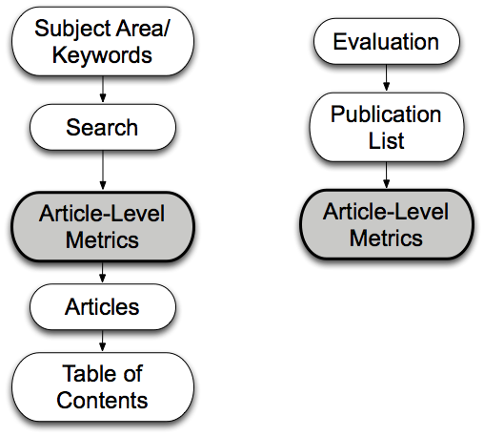
Integration of ALM into discovery and evaluation is work in progress
Notes:
We are still figuring out all the potential uses of ALMs.

Slide 15
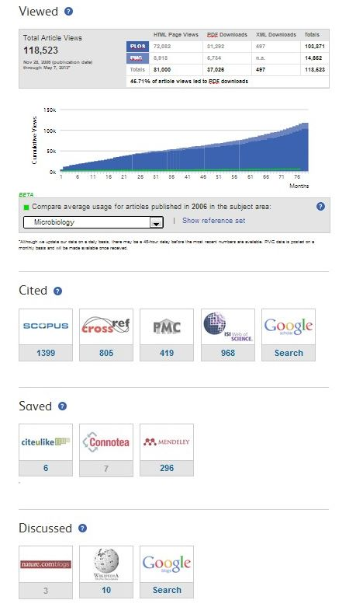
ALMs at work
article signposts
search result listings
sorting search results
related content author listings
RSS feeds
[article recommendations]
[researcher profiles]
[editor assignments]

Slide 16
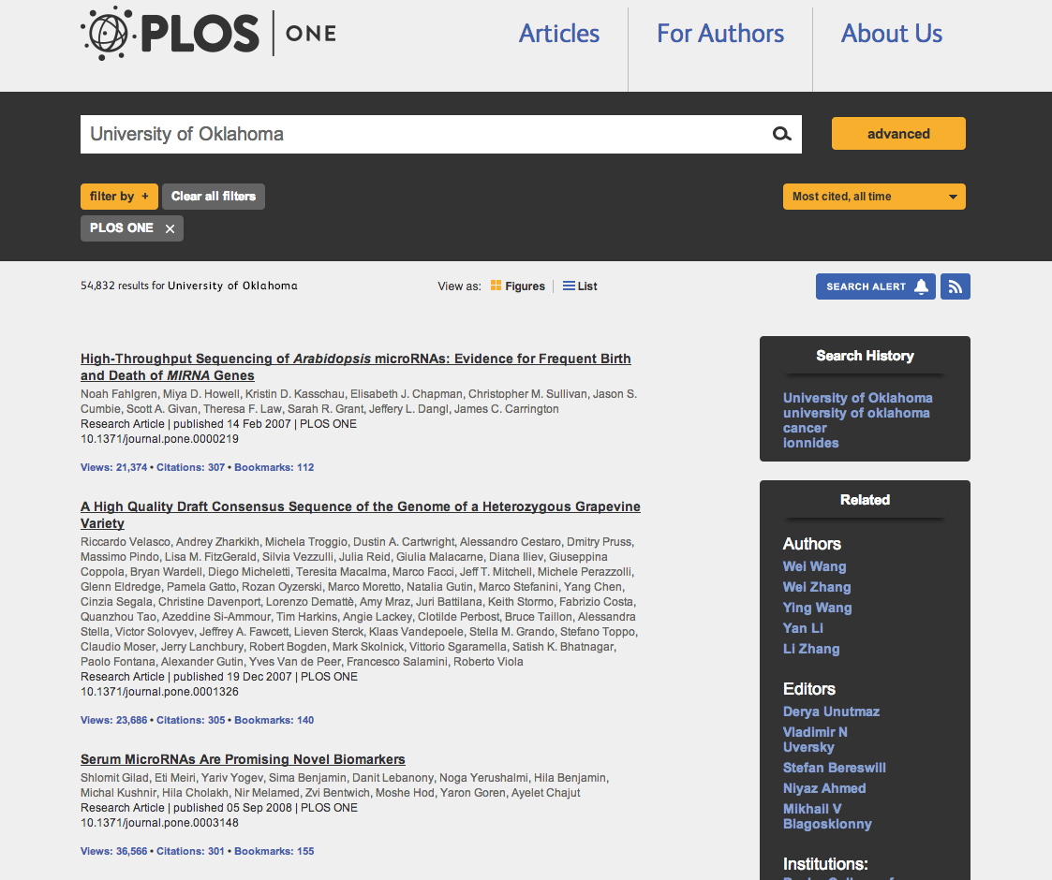
Notes:
Currently: Metrics tab, Signposts, Search and Filter, Related Content
Coming soon: Relative Metrics
ALM Reports – new and more direct way to access the ALM data. Create ALM reports based on custom search queries. Basic visualizations also included.

Slide 17
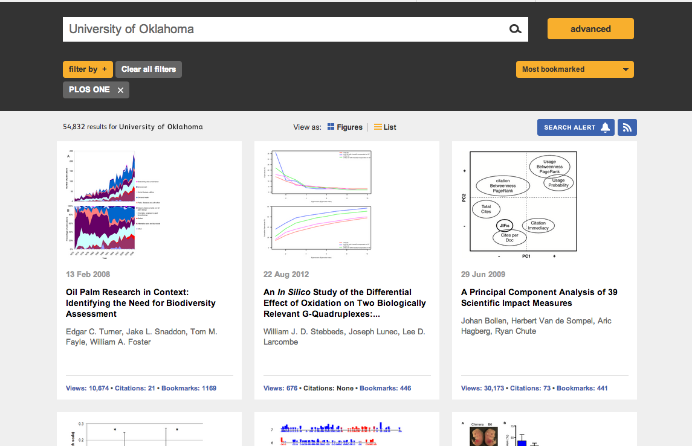
Notes:
Currently: Metrics tab, Signposts, Search and Filter, Related Content
Coming soon: Relative Metrics
ALM Reports – new and more direct way to access the ALM data. Create ALM reports based on custom search queries. Basic visualizations also included.

Slide 18
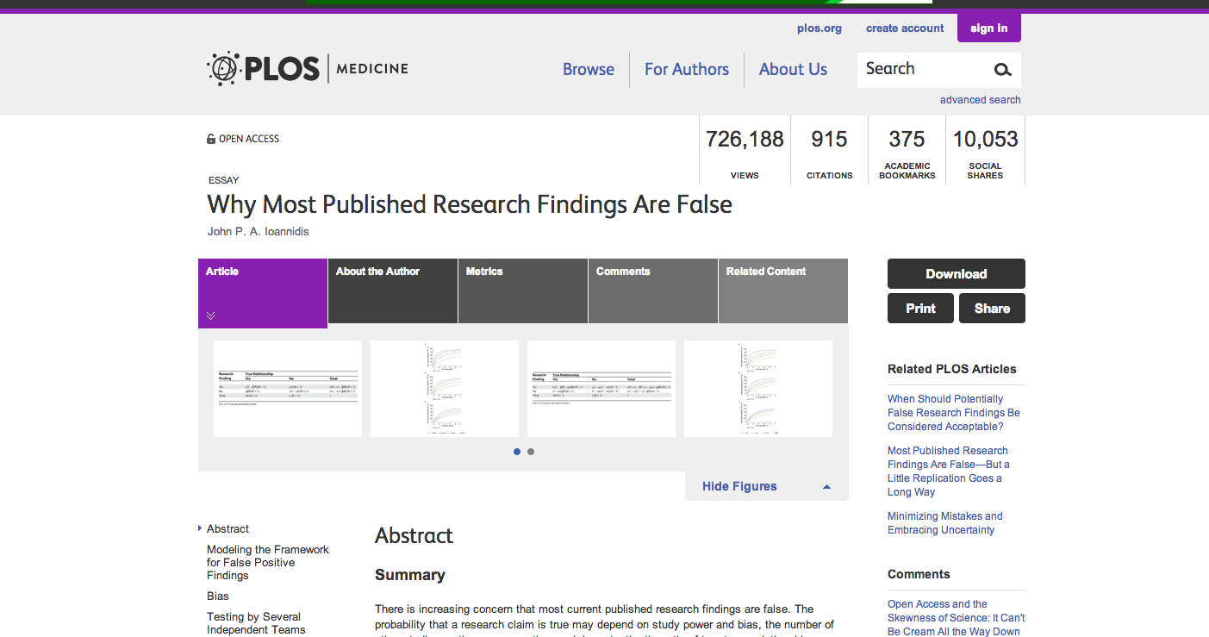


Slide 19
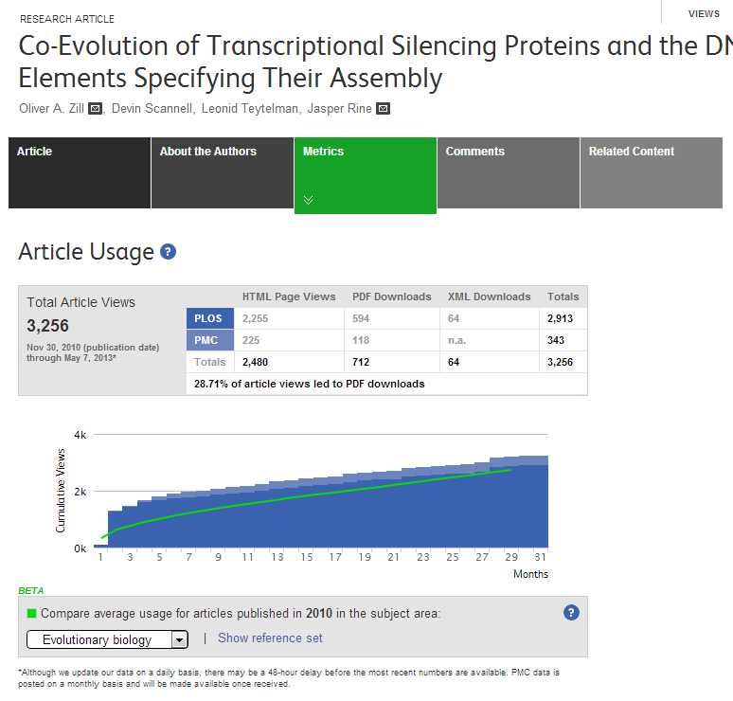
Views-downloads ratio
Average usage: calculation for 1st & 2nd level subject categories available
Incorporates papers of same publication year
Full reference set displayed (link)

Slide 20
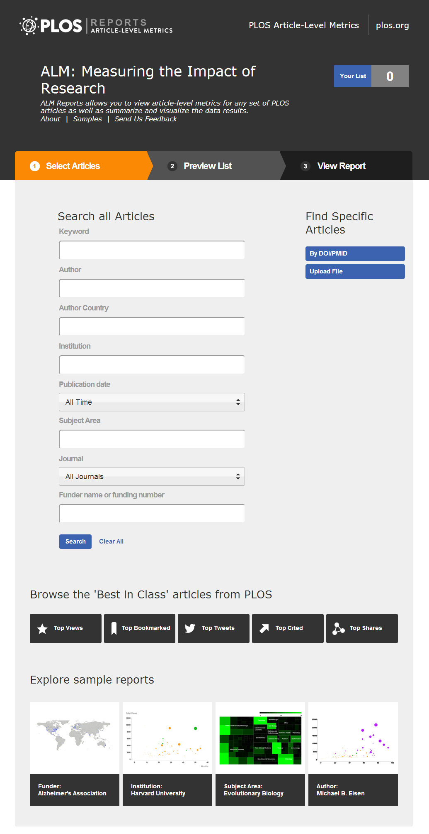
ALM Reports
The ALM Reports application allows researchers, institutions & funders to:
create a report of the ALMs for a single or set of PLOS articles
view a summary of the metrics along with an accompanying set of data visualizations.
Users will be able to search based on:
keyword
author name & country
institution
publication date
subject areas
funder
almreports.plos.org

Slide 21
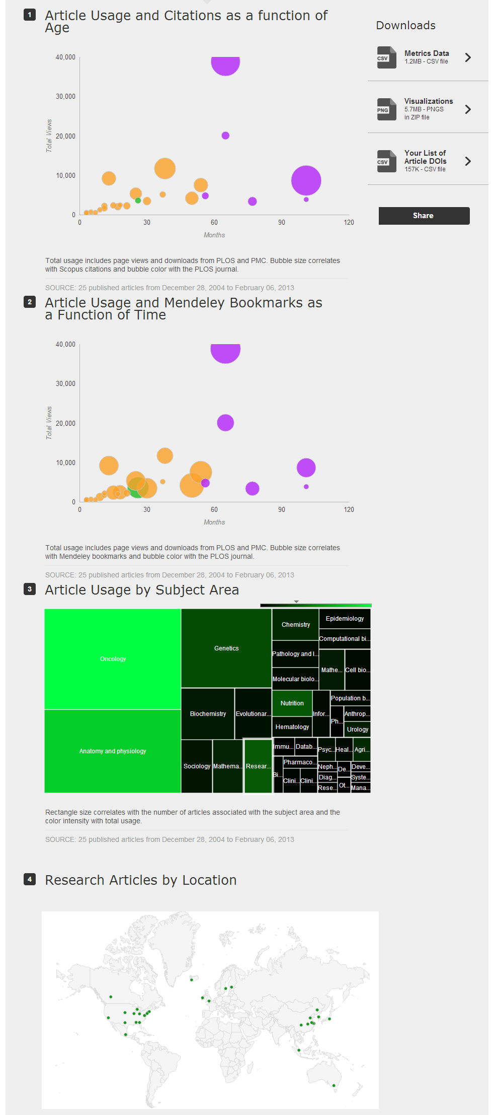
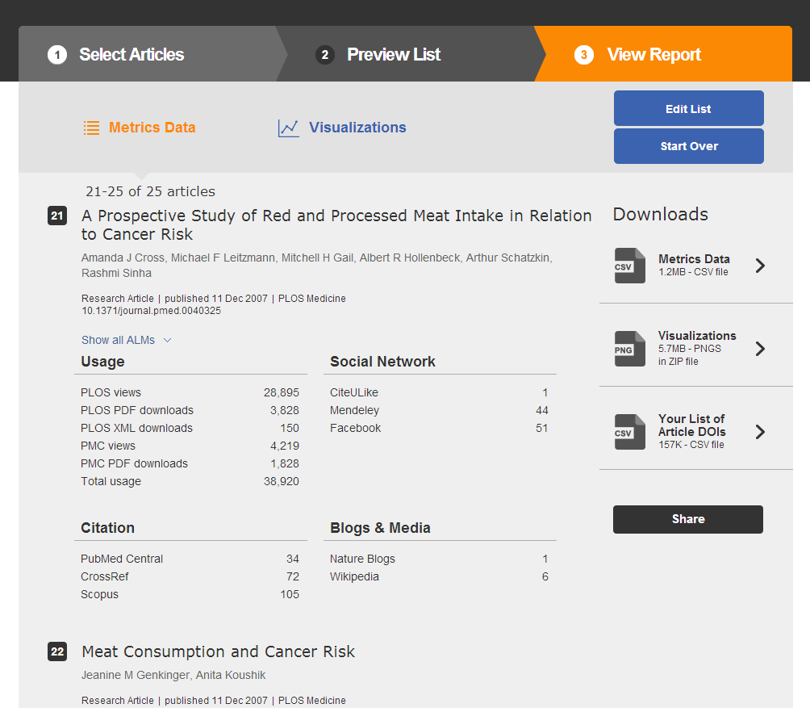
ALM Reports
Metrics Visualizations

Slide 22
Expanding utilization outside PLOS
Researchers use ALMs in various ways to track and communicate the progress of their work*:
With Whom?
University administrators, funding organizations (program managers), research collaborators, public relations departments & other promotion outlets
How?
* Author survey, July 2012
Formally: Curriculum Vitae grant & funding applications research assessments progress & merit report research reports | Informally: blogs, presentations, twitter web postings, conversations personal article management tools
Notes:
Results taken from author survey (July 2012)

Slide 23
Expanding utilization within PLOS
Improve Business Intelligence
Strategically invest in trending areas and break into nearby market segments
Optimize publicity efforts with more targeted campaigns (Call For Papers, conference presence, etc.)
Increase revenue stream by launching new collections of papers in areas of interest
Find new fields growing at the intersections between communities of interest
Expand advertising revenue with customized paid advertising
Improve marketing messages to communities of interest with data-driven decisions on everything from cover design to marketing text
Enhance direct marketing efforts for improved circulation and paid subscription rates (as applicable)
Deepen Editorial Capacities
Conduct cross journal analysis: identify what to focus on and what is lacking across published content
Manage and negotiate journal relationships and workflows when dealing with overlapping content areas
Assess the strength and validity of previous editorial decisions re: publication using a data-driven approach
Strategically direct invest editorial resources to promote new research of interest in growing fields
Identify promotion opportunities for papers and authors (writing press releases, front matter content, editorial overviews, etc.)
Uncover potential new authors
Deliver a Richer Product
Maximize front matter visibility with more valuable content
Create more targeted editorial overviews
Enhance press reviews and promotional content for high-impact papers
Streamline Publishing Operations
Effectively source papers in editorial board selection and reviewer assignments
Notes:
- ALMs arm the editorial staff with “live” tools to more effectively govern scholarly communications and administer editorial policies.
- With ALMs, publishers now have their finger on the pulse of the ever-changing research landscape. They gain a unique view of the most exciting research fields of the moment - the scientific problems, sub-specialties, methods, etc. - which are driving the direction of scholarly research. Publishers can then add value to their publications by delivering enhanced content in such areas.
- Articles are the most basic unit of the journal publisher’s product. As direct byproducts of the article, ALMs are metadata, which can inform publishers create more efficient and streamlined operational processes.

Slide 24
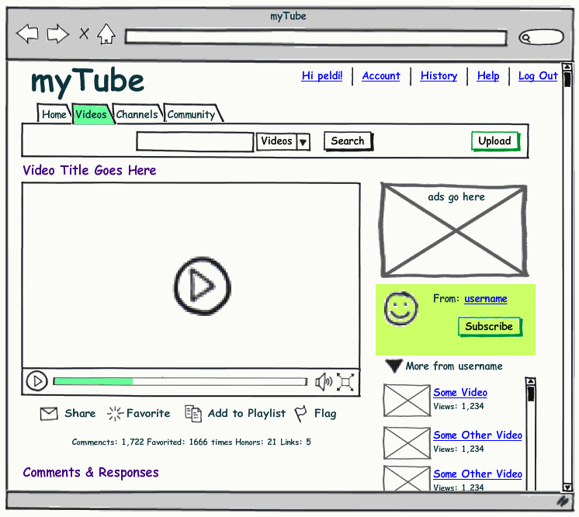
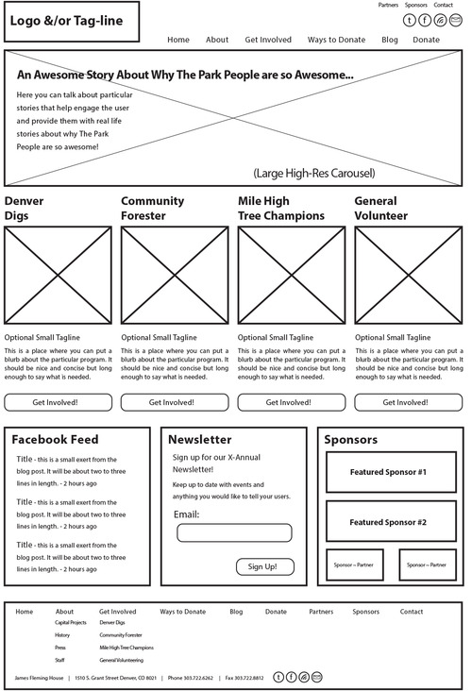
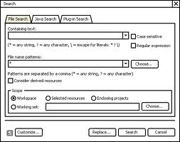
Altmetrics on the horizon
Researcher CV
Tenure Portfolio
Funding Application
myCV

Slide 25

No simple solution…
But that’s where opportunity lies.

Slide 26
Next steps
Coordination & standardization between data aggregators
Breakthrough technologies to measure the current “unmeasurables” (downstream impact)
Data validation and anti-gaming mechanisms
New services & tools
More bibliometric research to understand the new metrics

Slide 27
Access is Critical Keep it Open
Thank You
Jennifer Lin
jlin@plos.org
@plosalm

Slide 28
Miscellany

Slide 29
Nature of ALM data types - Issues to be aware of…
Landscape of data channels is constantly shifting
New data sources emerge and old ones disappear
Significance of each data channel constantly in flux (both waxes and wanes)

Slide 30
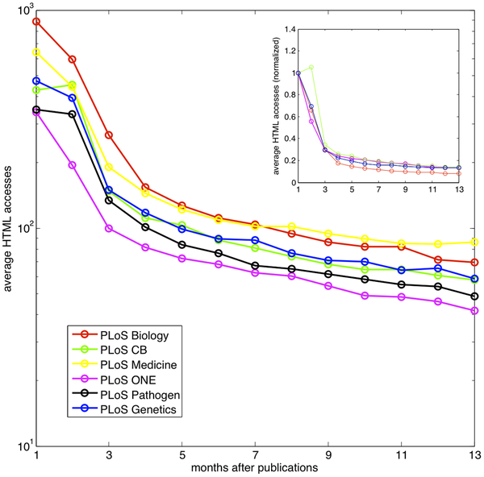
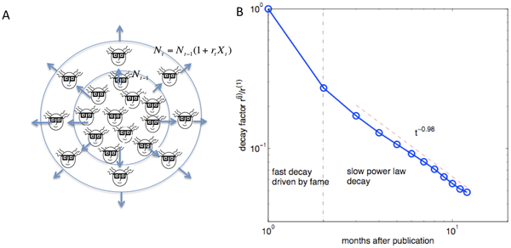
Metric activity depends on age of article
New papers – high rates of metric activity which decrease quickly
Old papers – little activity with slower decline
Decay process of usage (HTML views) in six PLOS journals
Yan K-K, Gerstein M, 2011 The Spread of Scientific Information: Insights from the Web Usage Statistics in PLoS Article-Level Metrics. PLoS ONE 6(5): e19917. doi:10.1371/journal.pone.0019917
Notes:
From the access statistics of 7000 publications published for at least one year, the number of HTML views of an old paper is lower. The decay process is much faster from the first month to the second month after publication, compared to the subsequent period. The inset shows the average accesses of different journals normalized by the corresponding values of the first month.

Slide 31
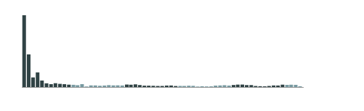
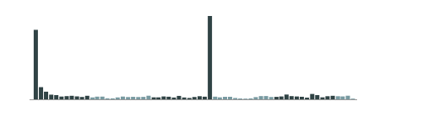
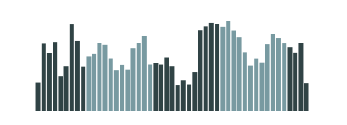

Articles differ in usage over time
Initial Severity and Antidepressant Benefits: A Meta-Analysis of Data Submitted to the Food and Drug Administration
10.1371/journal.pmed.0050045
Lifetime Medical Costs of Obesity: Prevention No Cure for Increasing Health Expenditure
10.1371/journal.pmed.0050029
The Preventable Causes of Death in the United States: Comparative Risk Assessment of Dietary, Lifestyle, and Metabolic Risk Factors
10.1371/journal.pmed.1000058
Preferred Reporting Items for Systematic Reviews and Meta-Analyses: The PRISMA Statement
10.1371/journal.pmed.1000097
HTML views per month from PLOS website (April 18, 2013)
31

Slide 32
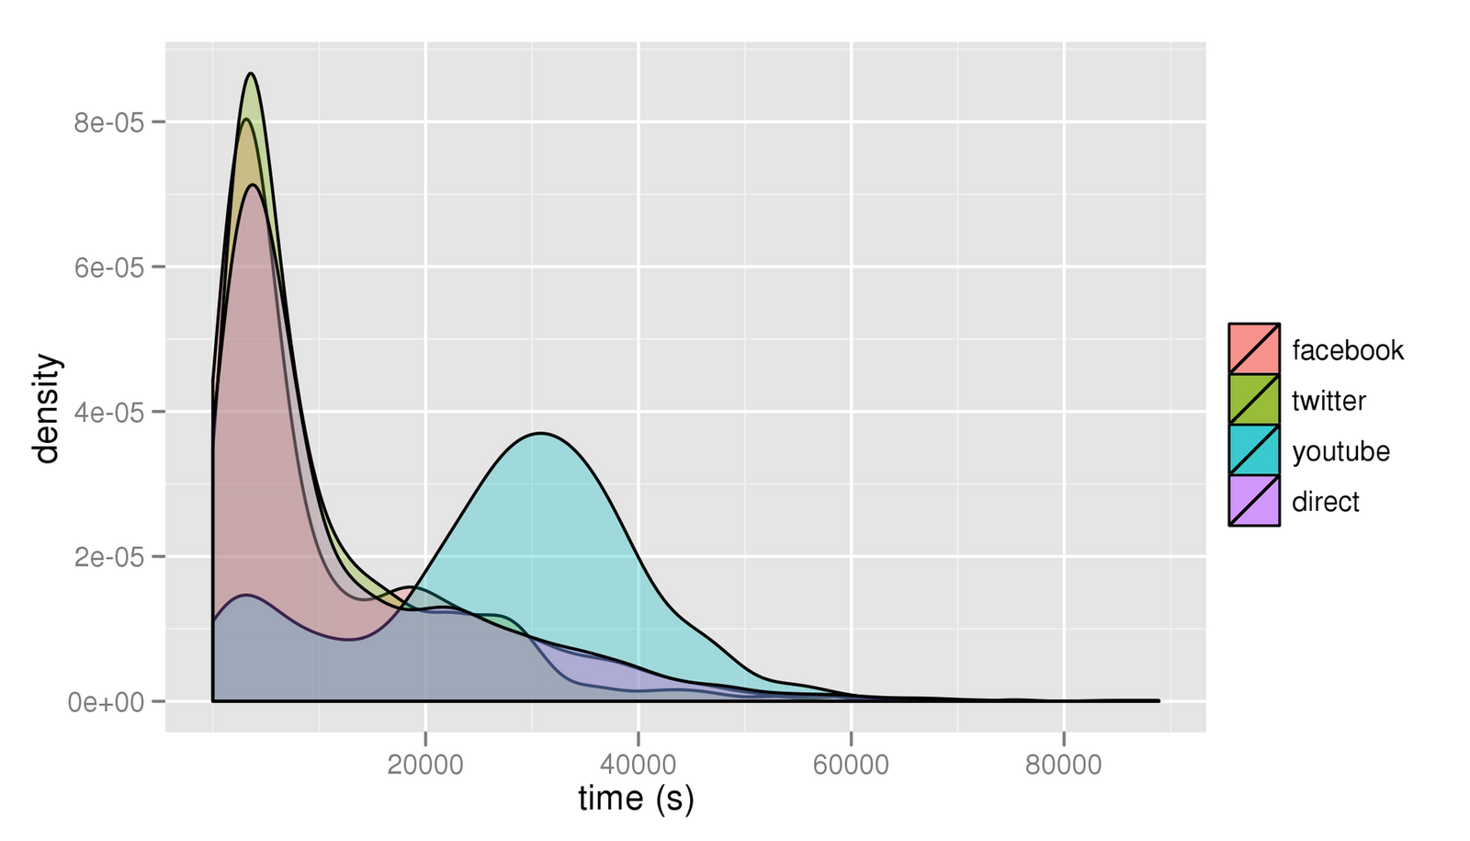
Dissemination activity also changes over time across data channels.
Ex: Social Media Channels
Bit.ly study of 1000 bitly links.

Slide 33
Data channels have disparate degrees of significance
Between channels
Ex: 1 blog reference ?= 1 Wikipedia reference
1 Tweet ?= 1 Mendeley bookmark
1 Facebook Like ?= 1 citation manager download
1 Facebook comment ?= 1 PLoS article comment
1 NYTimes citation ?= 1 New Scientist mention
Within channels
Ex: 1 blog reference ?=? 1 blog reference
Blogger Community
Engaged public citizen
Energetic graduate student
Veteran journalist
Nobel Prize Resarchr
And many more!...

Slide 34
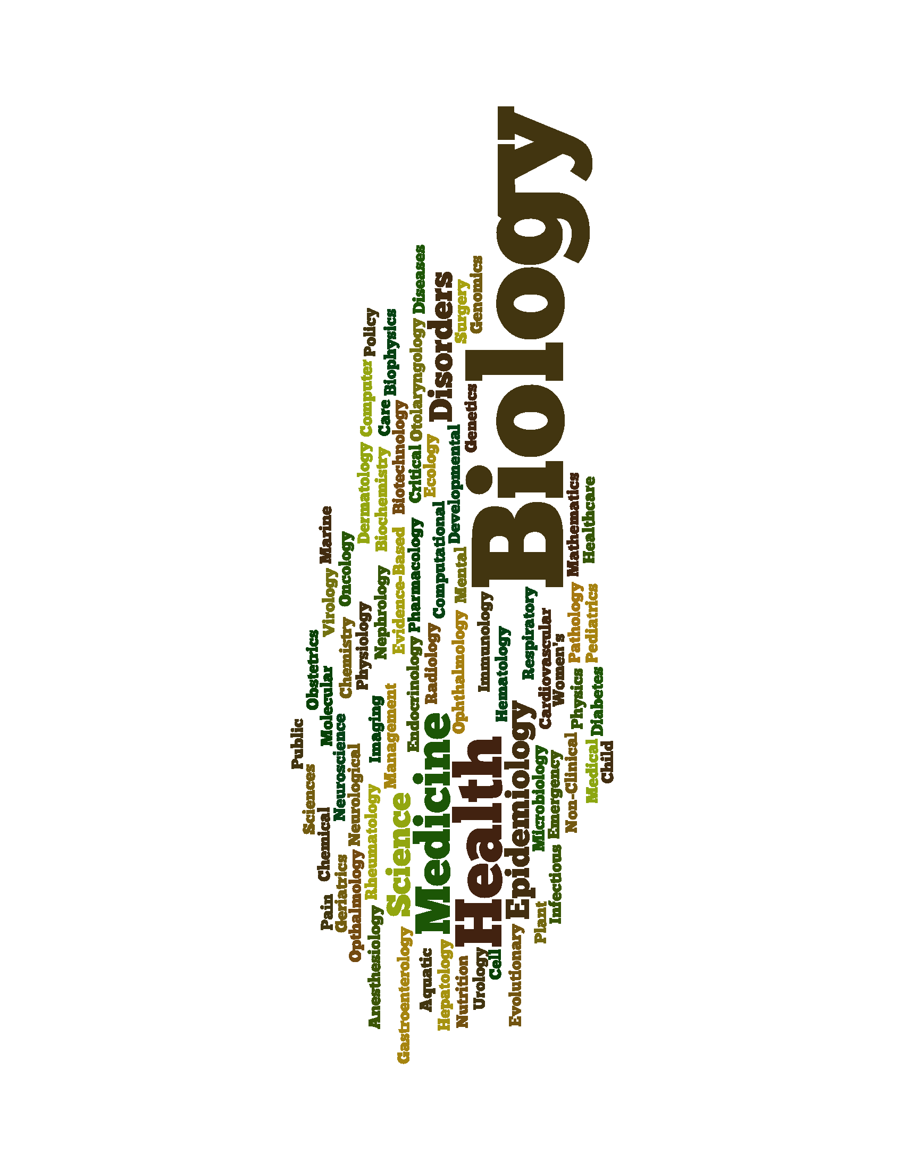
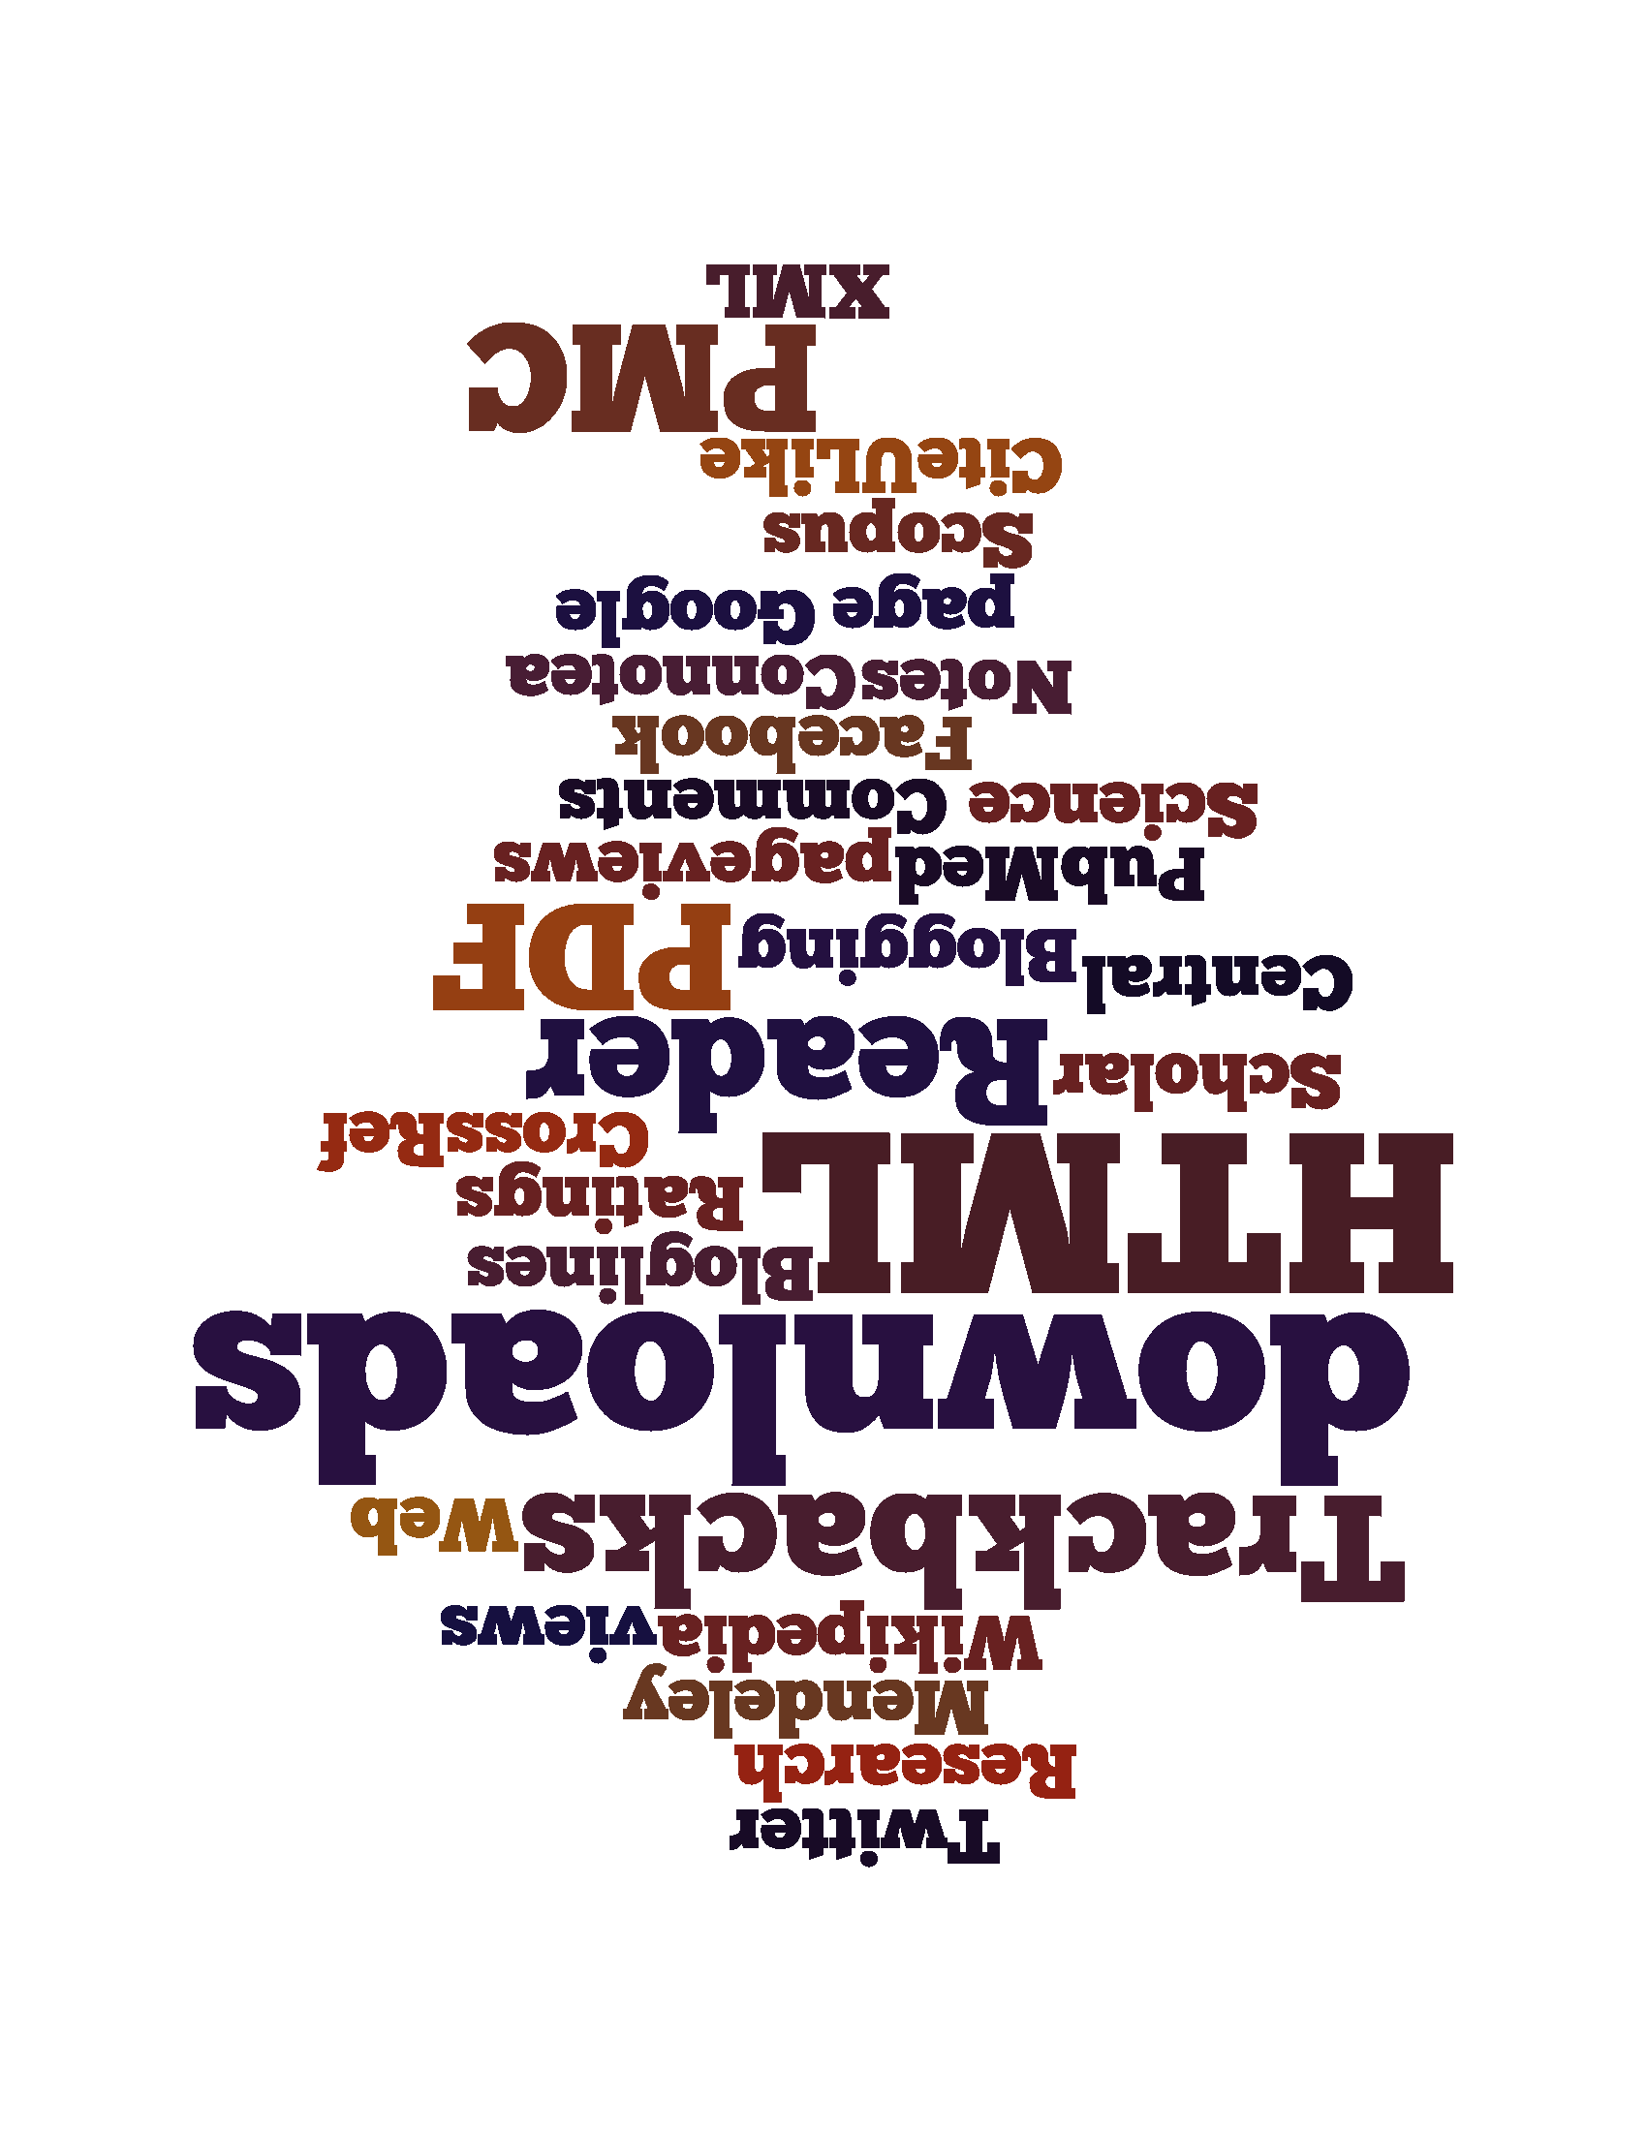
D. Wide variance exists in modes of engagement with papers:
No direct, fixed mapping
Diverse set of signals
Diverse notions of “impact”
Diverse communities of practice
Employ the most suitable set of metrics for each community & use
Notes:
34

Slide 35
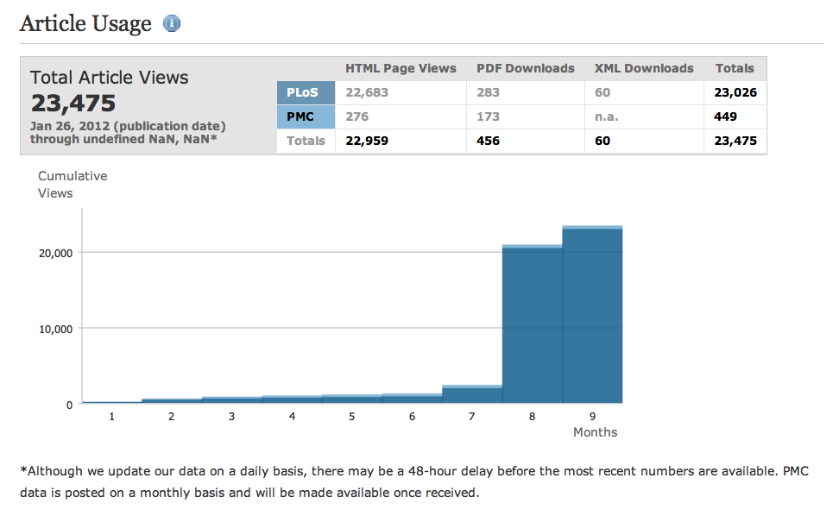
E. Gaming and Spam
Data integrity functionality
Community norms and policing
35

