Slide 1
Altmetrics and Traditional Metrics: What
Do Scholars Use to Judge Quality?
Carol Tenopir
University of Tennessee, Knoxville, USA
ctenopir@utk.edu
Fiesole
August 12-14, 2013

Slide 2


Trust and authority in scholarly communication project:
Funding by the Alfred P. Sloan Foundation
Research led by CIBER Research Ltd. in the UK and the Center for Information and Communication Studies (CICS) at University of Tennessee
September 2012-November 2013
Led by David Nicholas of CIBER and Carol Tenopir, Suzie Allard and Ken Levine of UT
Collaborators include Taylor & Francis, SAGE, PLoS, Biomedcentral, Wiley, and Elsevier
CIBER Research Ltd.
Notes:
partner

Slide 3

Aims of project:
Study how academics assign authority and trustworthiness to sources they read, cite, and publish in
Examine behaviors and attitudes of academics in changing digital times
Notes:
search engines and gateway services now allow academics to choose information based on access, speed, and visibility rather than established metrics of quality.
AND
Social media increases communication between researchers and has the potential to challenge established channels, so we set out to study how academics assign trust to all types of intormation and how these assignments of trust may be changing.
We also set out to discover how academics make choices and how they decide to spend their time seeking, selecting, citing and disseminating scholarly content and how they think that has changed.

Slide 4
TRUST:
Quality, Reliability, Trustworthiness
All in all then, perceived quality/reliability/trustworthiness is the prime criterion scholars use in the discovery process (finding information), in the information management process (separating dispensable from indispensable relevant material), in the citation process (formally using information) and in the dissemination process (where and how researchers choose to have their work published).

Slide 5




Studies of reading patterns provide context for trust:
Surveys by Tenopir & King 1977-2013
Article and book reading of academics reveal patterns, outcome, and value
Changes over time in reading patterns, are there also changes in trust?
Notes:
I will tell you about some of the results from the ongoing interviews and completed focus groups, but I am also going to interweave in todays presentation findings from my recent surveys of reading patterns among academics. These are ongoing studies for a long time, most recently done in the UK, US, and Australia. In these studies we look at reading patterns mostly (where readings are found, what is read, outcomes and use and value). Here we have a picture of change as well and these studies provide some context to the interviews and focus groups.
So, I will cover overall reading patterns and trust in the past and today then focus in on the 3 most commonly mentioned themes in the focus groups: 1) impact factor; 2) social medial; 3) open access.

Slide 6
Average readings by academic staff in Australia, U.S. and U.K.
n=2117, 6 UK institutions, June 2011
n=837, 5 US institutions, January 2013
n=133, 2 AU institutions, 2012
Notes:
This represents a big investment in time.
Of course this varies by subject discipline—medical academic staff read many more articles (average of 44 in Australia) and Humanities academic staff many more books (average 13 in Australia). Australia respondents have more medical faculty…
UK Totals:
Articles: 22/month; Book: 7/month; Other: 10/month
US totals:
Articles: 21/month; Books: 7/month; Other: 10/month
AU totals:
Articles 25/month; Books: 7/month; Other: 8/month
ALL (Combined) totals:
Articles: 23/month; Books: 7/month; Other: 10/month
All (Combined) Annual Totals:
Articles: 276
Books: 84
Other Publications: 120
(Total scholarly reading per year is 480)
AU Annual Totals:
Articles: 300
Books: 84
Other Publications: 96
(Total scholarly reading per year is 480)
US Annual totals:
Articles: 252
Books: 84
Other Publications: 120
(Total scholarly reading per year is 456)
UK Annual totals:
Articles: 264
Books: 84
Other Publications: 120
(Total scholarly reading per year is 468)
Varies by discipline (UK, UIUC)
Sciences
27
33
Engineering/Technology
28
21
Medical Science/Health
31
44
Humanities
28
22
Social Sciences
21
20

Slide 7
Article Readings 1977 to Present by Scientists and Social Scientists in the US
Readings per year
*
*2012, n=837; 2005,n=932; 2000-03, n=397; 1993, n=70; 1984, n=865; 1977, n=2350
Notes:
Excludes outliers and humanities. 298 in the UK, 283 in the UIUC to date

Slide 8
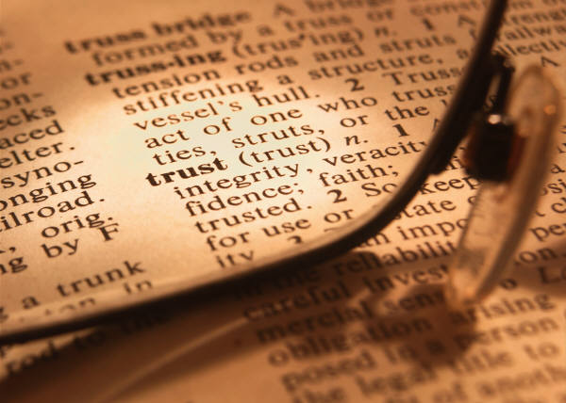
The reality of trust:
They read many things they “trust” but would never cite (e.g. Wikipedia)
Politics influence citing and publishing
Cite to protect yourself and add “trustworthiness”
Publish to help your career
Use different criteria for reading, citing, and publishing
Notes:
In the focus groups several themes emerged. They will read many things they “trust” that they would never cite (e.g. Wikipedia). There are politics and other factors influencing what they cite and where they publish. You cite to protect yourself and add “trustworthiness” to your publication, and publish where it will best help your career or where you can get published.

Slide 9

How trustworthiness is determined for reading
Read abstract and methodology
Look at source’s references
Colleague recommendations
Familiarity with author or journal
Peer-review linked to quality
Impact factor a factor...
Notes:
To determine trustworthiness use many clues

Slide 10

How trustworthiness is determined for citing
The author is known and trusted
The journal or conference is known and trusted
Seminal work in the field.
Supports methodology
The research group/institution is known and trusted
Notes:
Top five reasons why participants thought a source was trustworthy based on interviews (42 US).
Other reasons can include:
Reviewer/editor recommended it.
Cited a lot
Agenda free
Author/co-author wrote it
Found it in an authoritative/trustworthy source
Rarely cite because:
Convincing alternative argument
Informal source
Known website

Slide 11

How trustworthiness is determined when deciding where to publish
Traditional metrics (e.g., impact factor) still important
Influenced by tenure and university
Audience of a journal
Likelihood of getting published
Notes:
Traditional metrics: They use metrics more often when publishing than when citing/reading. They become more important because the university often uses them when giving tenure/promotion credit.
Often researchers care less about the trustworthiness of the journal and more about if it will help them get tenure. Older researchers are more likely to publish in more “innovative” journals/sources because they do not need tenure.
Audience: Who will read the article? They want to publish in a journal that has the intended audience, but they admitted that sometimes tenure-requirements can interfere (would chose tenure over audience normally).
Likelihood of getting published: Want to publish in top-tiered journal but less chance of getting published, so go down the list until you get to a more likely journal. There can be too much competition in the top journals.

Slide 12
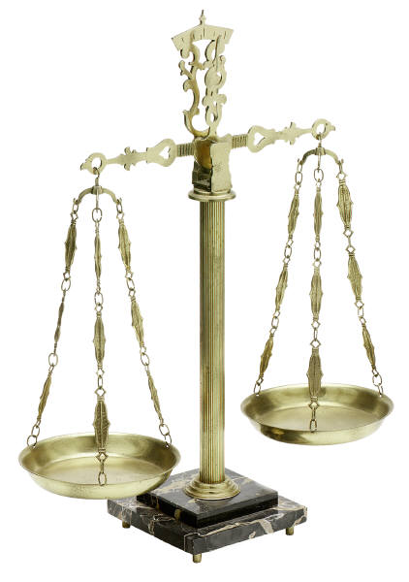
Trust and Impact Factor
More important for deciding where to publish than what to read or cite
Recognize that low-quality articles could be published in high IF journals
High IF journals may lack innovative and fresh papers
On the whole, younger academics trust impact factor more than older faculty
Notes:
(Scale supposed to represent that there is a give and take with determining trust. It is not a perfect system but you have to weigh what is more important. E.g. well-known author in poor journal or unknown author in high IF journal)

Slide 13


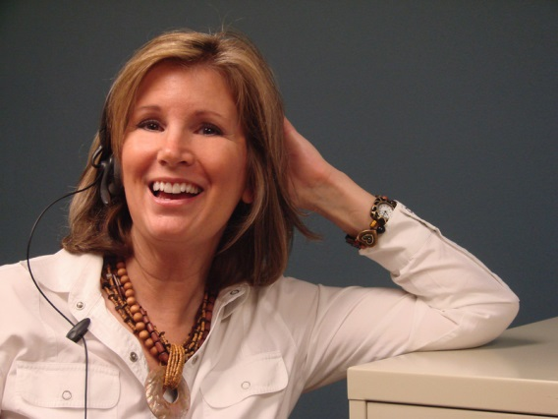
Comments on Impact Factor
“My tenure committee cares [about impact factor] but no one else does.”
“It’s an imperfect method but it’s the only one we have.”
“It’s good because you want people to pay attention to your work BUT high impact factors do not always have the right audience for those who would use your work.”

Slide 14
Trust and Altmetrics
Most participants were unfamiliar with concept.
Others were skeptical of what the various altmetrics actually meant.
Participants do like metrics that can be quickly understood.
Authors like being able to see the number of people who have viewed or downloaded their article.
Although they didn’t use the term, some alternative metrics were mentioned...
Notes:
Altmetrics were not mentioned in the US—may be because of our questioning.
This slide is based on the UK focus group summary.
Skeptical: Just because someone views an article doesn’t mean they think it is quality/trustworthy.
On a positive note: participants do like metrics like downloads, page views, etc. that can be quickly understood. So maybe altmetrics will “catch on”.
A couple of US interviewees said they liked seeing the number of downloads/viewings of their article in OA journals like PLoS.

Slide 15

What is Trust in online environment?
I think it is “connectiveness” through name of friend who sent the link. You need to connect to a source to have trust. If information is isolated, just floating out there, I don’t trust it, but if it is connected to others then I trust it.
Notes:
I think this quote sums up a lot of the comments we received.

Slide 16

Have digital communications changed how trust is determined?
“There is no one way to share or spread information, but do I want to trust all these new things?”
“I’ve broadened what I consider a reliable source. It is easier to verify a source and I am less tentative.”
“Can no longer just say “only peer reviewed”. I’m unlearning what I used to do. I have to re-assess reliability when everything already digital. I used to be comfortable with print.”
“We are better researchers in the digital era because we can look at research in more modalities.”
Notes:
People are also more cynical as they get older. They see the politics and competition that can interfere with academic pursuits.

Slide 17


Open Access
A lot of confusion
PLoS One considered trustworthy
Common thoughts:
  Too expensive
  Lower quality
  Quick publication time
  No review system
  Suspicious of journal’s motives
Notes:
Common thoughts are not necessarily true statements but shows the confusion around OA.
If OA had peer-review system that would increase the trust in it. OA would also benefit if tenure/promotion gave credit for OA publications.

Slide 18

Use of Social Media
Image from: shopforfollowers.com
Notes:
How often do you read, view, or participate in each of the following electronic or social media tools for work related purposes?
Blogs
Youtube/Video
RSS Feeds
Twitter
User Comments in Online Articles
Podcasts

Slide 19
Use of specific social media varies
UK
US
Percent
UK n=2117; US n=579
Notes:
But the specific type they use varies quite a bit. Blogs, videos, and user comments are the most commonly read or watched.
“How often do you read, view, or participate in each of the following electronic or social media tools for work related purposes:” (Rank from Daily to Never; these percentages include those ranked daily, weekly, monthly or occasionally)
Some of the other answers included: e-mail and research websites.

Slide 20
Top 3 social media used just occasionally (U.K. 2011)
100%
Percent
n=2117, June 9, 2011, 6 U.K universities
Notes:
Of those top 3 the use is pretty infrequent, with 60-70% of faculty saying they use these top 3 only occasionally. Daily or weekly use is most common with blogs, about a quarter say they use blogs at least weekly.
[These 3 tools are the most commonly used]

Slide 21
Top 3 social media used occasionally
(U.S. 2012)
100%
Percent
N=579
Notes:
(social networking was not asked about in the UK)

Slide 22

Comments on social media
“Same issues with social media as with art. We may pretend to know what is “good art” but often we don’t really know, so how can you judge quality with no basis?”
“There are different levels of quality of tweets. I don’t cite Twitter but I may use report linked via Twitter.”
“I use Wikipedia to remind myself what I once knew.”
“Social media can make top-tiered research more accessible.”

Slide 23






Influence of trust on use of social media
Most are engaged at least occasionally.
More critical and hesitant about trusting.
Use many of the same standards to judge quality of social media as they use for traditional sources.
Less trusting because no standard to judge quality.
Less likely to create because not rewarded by university or tenure committee.
Notes:
Also, often connect to people they know in real life rather than connect with new people on Facebook, linkedin, etc.
More people trust Wikipedia (but would never cite it).
Logos on slide:
Academic.edu (navy blue)
Twitter (blue bird)
Facebook (blue f)
Blogger (orange square left “b”)
LinkedIn (blue in)
RSS feed (orange right)

Slide 24
Overall findings:
Traditional metrics (e.g., impact factor) are trusted even though flaws are acknowledged.
Confusion about Open Access.
Tenure and University policies influence what scholars trust.
Impact Factor is more important for publishing than reading or citing.
Scholars read abstract, methodology, and references to determine trustworthiness.

Slide 25
Trust and Authority in digital environment
Phase 1: Scholarly communication
Phase 2:
Communication outside academia
Phase 3: Communication in other countries
Phase 4: Mobile communication
Academic researchers UK & US
Government researchers
Lab researchers
Corporate researchers

Slide 26
Thanks!
For more information: http://cics.cci.utk.edu/cicsprojects/Sloan
Carol Tenopir ctenopir@utk.edu

