Slide 1



The Potential of Linked Data
Stephen Rhind-Tutt, President
Singapore, August 2013
Notes:
1

Slide 2
Overview
Some background
The landscape - challenges facing academic publishing
What’s the role of (open) linking?
ASP’s experience of linking between databases
Inbound links
Outbound links
Are we moving fast enough?
Where will it end?
If we have enough time…a couple of exciting projects
Notes:
Want to start with some background. This talk is going to be from the perspective of an independent, ‘born digital’ publisher.
Then I hope to stun you with the size of the challenge facing us. Show how important linking is to meeting that challenge. Give you some practical examples of what we’ve done to date. Finally some general comments about the state of linking as a whole.

Slide 3
Some background
Notes:
I’ll be talking from a publisher’s perspective…

Slide 4

Alexander Street Press
13 years old
100+ people
Based in Alexandria, Virginia
Offices in the UK, ANZ, Kuala Lumpur, Shanghai
‘Born digital’ publisher
Improve access and utility for learning and research
Notes:
4
We didn’t have any content to start with. So we weren’t constrained. Important because sometimes we’re told that what we’re doing isn’t publishing. My contention is that although the word is changing it’s meaning, putting out non-machine readable content that won’t maximize learning or research isn’t publishing either.

Slide 5





Our Purpose
Make silent voices heard
Notes:
We take materials that should be used more and we make them easier to access, better to use and more functional

Slide 6







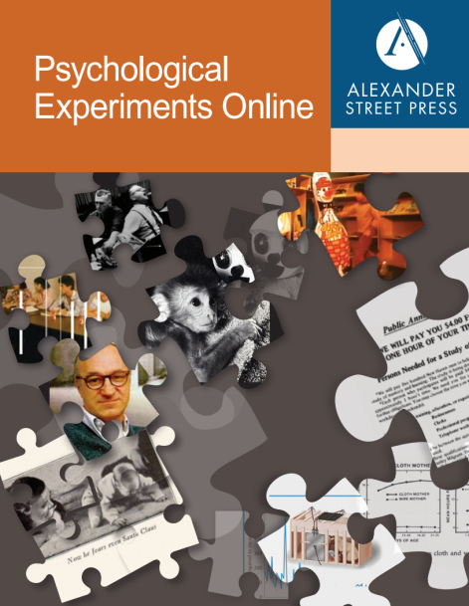
Some of our publications
Notes:
We’ve branched out into many disciplines where primary sources haven’t gone before! We’re one of the largest vendors of streaming video and music into libraries in the world.

Slide 7
The Landscape….challenges facing us

Slide 8
By 2020 the web will contain…?
90% of published works prior to 1923
Majority of works published to 2020
> 100 billion pages of e-mail, phone logs, databases, blogs, and Web sites (currently 45 billion)
> 1 Trillion Photos (As of 1/13 Facebook had 240 Bn photos. 1.1 Bn uploaded over New Years alone)
> 100 million facsimile pages of manuscripts
> 30 million published audio files
> 2.4 Bn video files on YouTube (1 Bn unique users per month)
Notes:
http://techcrunch.com/2013/01/17/facebook-photos-record/
Facebookers Feed Graph Search And Set A Record By Uploading 1.1B Photos On New Year’s Day/Eve
Josh Constine , Thursday, January 17th, 2013
http://www.youtube.com/watch?v=jpYCUn22l-E
How many videos are there on YouTube?
Published on Oct 30, 2012
Website: http://www.EducateTube.com | Host: Sipski

Slide 9

Exponentially more use…
>1 billion unique users monthly
>4 billion hours watched monthly
72 hours of video are uploaded every minute
70% of YouTube traffic comes from outside the US
In 2011, YouTube had more than 1 trillion views or around 140 views for every person on Earth
http://www.youtube.com/yt/press/statistics.html 4/3/2013
Notes:
http://www.youtube.com/yt/press/statistics.html 4/3/2013

Slide 10
What does this have to do with academic publishing?
Notes:
http://www.youtube.com/yt/press/statistics.html 4/3/2013

Slide 11
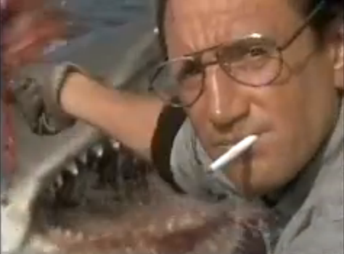
Watch out…

Slide 12
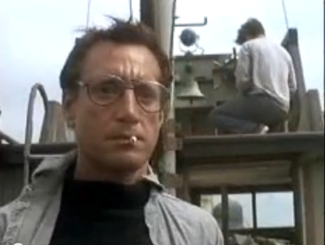
We are going to need bigger boats

Slide 13
What happens when?
(Almost) all content is machine readable
(Almost) everyone can access it instantly
(Almost) everyone uses it
Machines must help us learn, discover, understand
Search
Publish
Analyze
Process data
Identify patterns
Draw conclusions
Etc…
To do e-science, e-humanities,

Slide 14
Evolution of publisher tasks
Process integration
Workflow tools
Semantic indexing
Commissioning
Linking
Community building
Asset management
Free materials
Editorial
Rare and unpublished material
Licensing
Unified search software
Simple, one database search
Public domain reprints
Warehousing
Quality
Print directory
Selection
Print monograph
Printing
Typesetting
Fading
Growing

Slide 15
What role does (open) linking have to play?

Slide 16
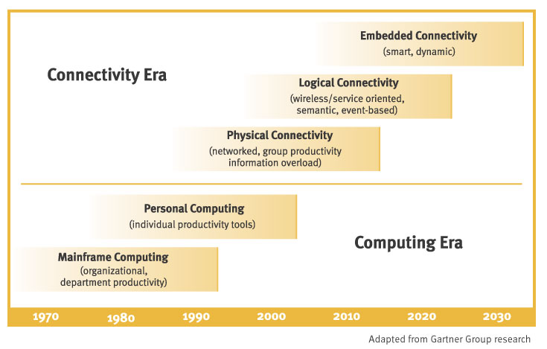
It’s the next hurdle
Notes:
This chart comes from OCLC’s 2003 Environmental scan – and you can see it’s been right on the mark.

Slide 17
It’s the nature of the Web
Page
Page
Page
Page
Page
Page
Page
Page
Page
Pliable
Constantly evolving
Practically unlimited in size
Atomic
Interconnected
Interdependent
Value of the Connection = Value of the object
Notes:
It’s a key feature of the web – in the same way a key feature of paper is that it can be printed on.

Slide 18
Linking
Speeds research and learning
Fewer interfaces to learn and navigate
Reduces duplication
Increases comprehensiveness
Allow unified annotation and
Lowers costs
Libraries don’t purchase same content twice
Publishers don’t need to license and re-sell ubiquitous content
Obviates need for updates
Maximizes usage
Content can be part of every search
Increases functionality
Allows machine manipulation of data
Linkages not just between content but between apps

Slide 19
It’s the future of academic publishing…
We seek knowledge and learning, not journals, books and publishers
Publishers need to deliver the right content, in the right way to the right people.
In a network a node is less important than the links between the nodes. No one site will have all information
We need actionable, high quality access to content across different publishers, libraries and websites.

Slide 20
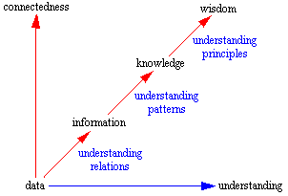
Where we’re headed
Why?
Therefore
Who, What, When, Where?
After Data, Information, Knowledge, and Wisdom, Gene Bellinger, Durval Castro, Anthony Mills. http://www.systems-thinking.org/
Notes:
Connectedness is intrinsic to information, knowledge and wisdom. If we’re to enable machine to help us to the maximum it’s a journey we have to take.

Slide 21
ASP experience in linking

Slide 22
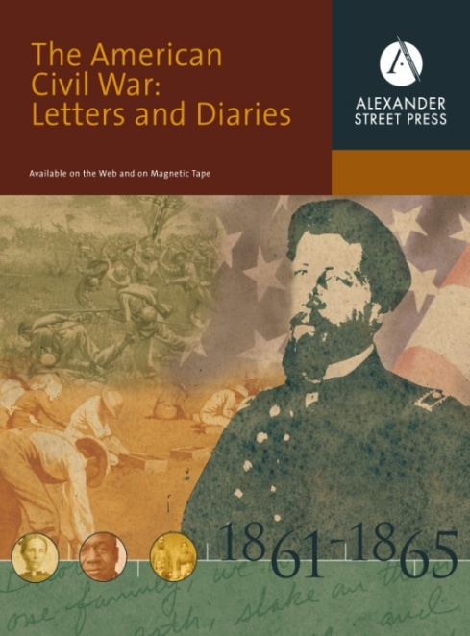



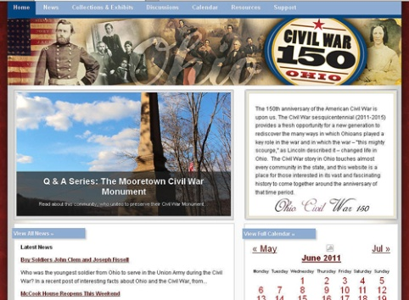
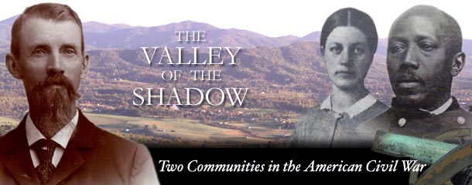
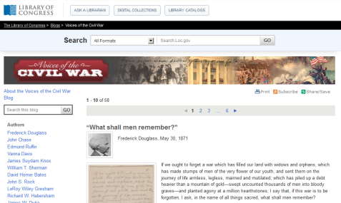
Building The American Civil War Online
How to build links between lots of relevant but different files?

Slide 23
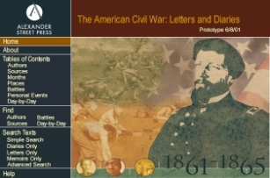

Began with…
100,000+ pages, including previously unpublished manuscripts
Notes:
This was one of ASP’s first products…

Slide 24
Analyzed what’s studied in the “real” world
Battle
Song
Event
Author
Article
General
Location
Battlefield
Rank
Book
Skirmish
Company
Gun
Casualty
Army
Captain
Memoir
Diary
Date
Letter
Acts
Promotion
Navy

Slide 25
Built a structure to capture it…
Document
Battle ID Author ID Event ID Source ID Date Subject
Age writing
Battle
Author
Event
Source
Where ?
When ? Who ? Deaths Leaders
Etc…
Birth ?
Death ? Where ? When ? Occupation
Etc…
Day Event Etc…
Source Editor Publisher Place Etc…
Notes:
We organized materials into controlled vocabularies…

Slide 26
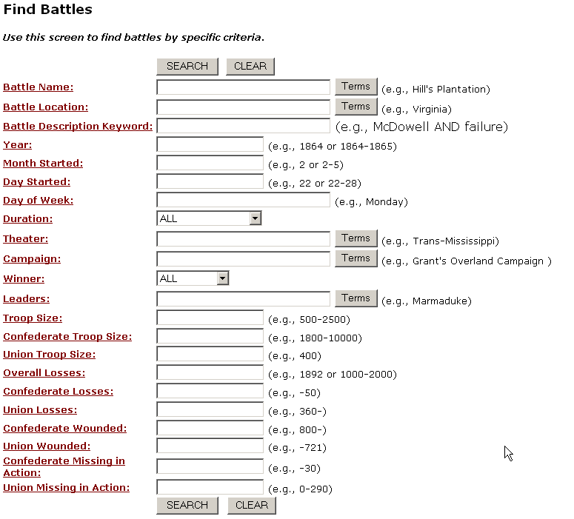
Notes:
Here’s the battle file – really enables some great functionality.

Slide 27
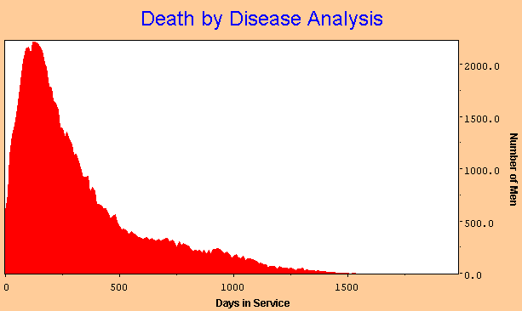
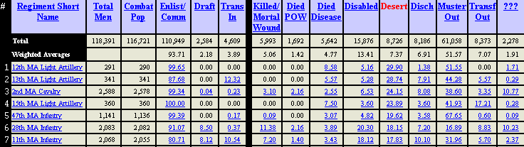
Launched theCivil War Research Database

Slide 28

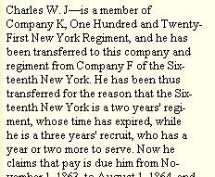
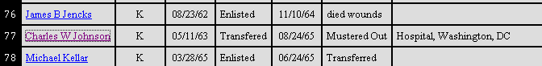
User wants to cross search and cross link
Illustrated Civil War Newspapers
American Civil War Research Database

Slide 29
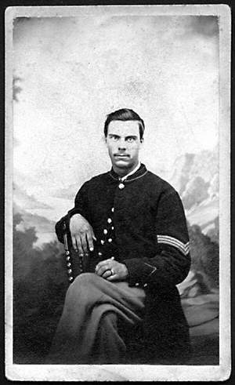
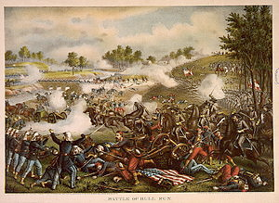
Resource Description Framework (RDF)
Charles W. Johnson
Fought in
Battle of Manassas
Subject
Entity
Object
Entity
Predicate (Property)
Make the system understand how things are connected
Notes:
Not just what’s connected, but how it’s connected.

Slide 30

Reconcile the semantic entities
Civil War Research Database
5,441 ‘battles’
Includes skirmishes, naval encounters
Individual details
July 21st - Bull Run
US National Park Service Database
382 ‘battles’
Land based only
Major developments
No individual details
July 21st – Manassas
What is a battle?
When does a battle begin?
Where is a battle actually fought?
Inference issues: if Johnson was in the 124th regiment and the 124th fought at Bull Run can we assume he fought at Bull Run?
Etc….

Slide 31
Entity matching isn’t easy…
Place (geocodes) and Date are
Universal
Authoritative
Comprehensive
Standardizable
Other vocabularies not so straightforward
UMLS unifies over 150 medical subjects such as ICD-10, MeSH, SNOMED CT, DSM-IV and more
Requires Continuous error correction, updating and improvements.

Slide 32
Add lots more dbs and content
How to build links between lots of relevant but different files?

Slide 33
Automated entity/property extraction?
Machine aided indexing tags subjects, names, places
Struggles with relationships
Work has been going on since the 1990’s
Some success, but most had to be done manually

Slide 34
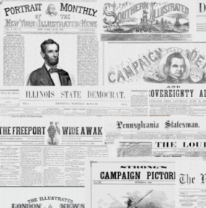
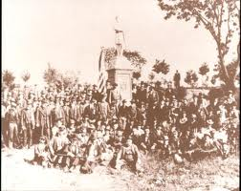
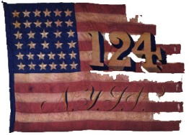
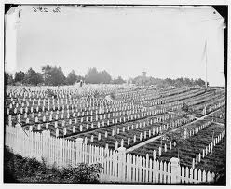
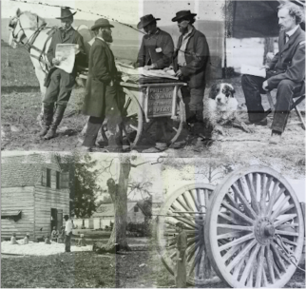

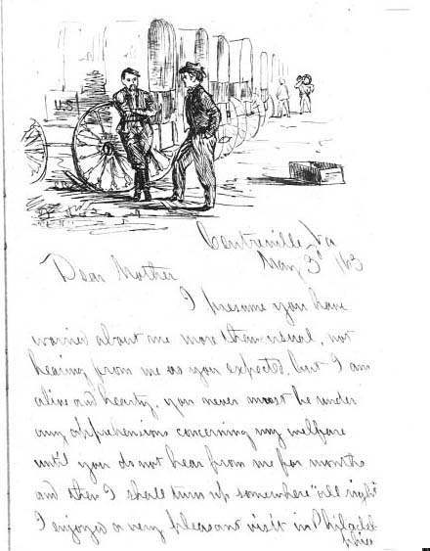
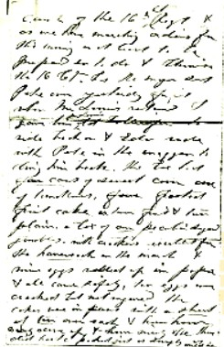
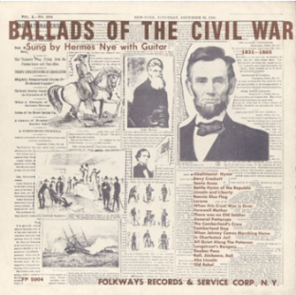
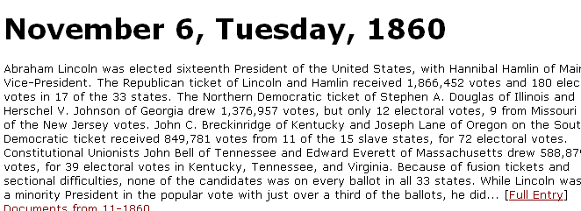
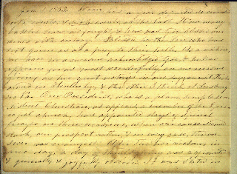
Make relationships linkable (in process)
Fought Under
Is mentioned in
Enlisted in
Died in
Is a photo of
Died on
Wrote
Sung this song

Slide 35


























Goal: Inbound and outbound links to all
Websites
Music
Newspapers
Primary Works
90 databases
25,000 video titles
>1m tracks of music
>5m pages of text
1.2m digital objects
Monographs
Journals
Notes:
35

Slide 36
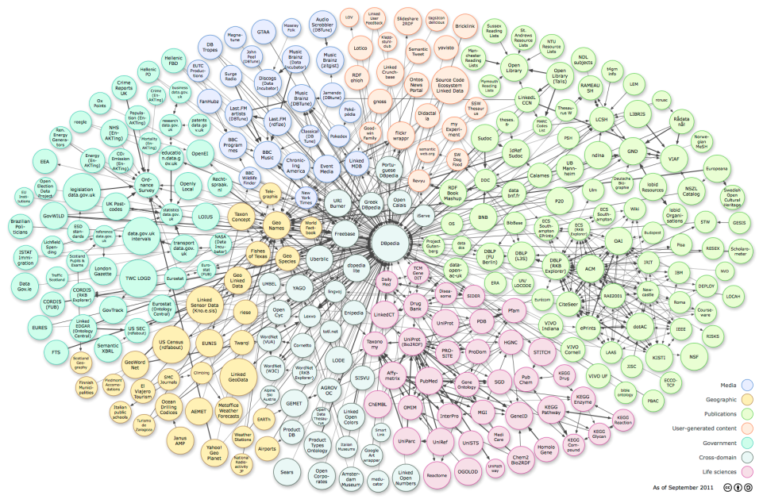



Steps to integration
All linkable content
All Alexander Street Content
The American Civil War Online
The American Civil War Letters and Diaries
Not to scale ;)
Notes:
From an individual database we move to grouped databases, then to all ASP databases – that’s the stage we’re at now. Thence to link this to all relevant, quality content that’s out there.

Slide 37
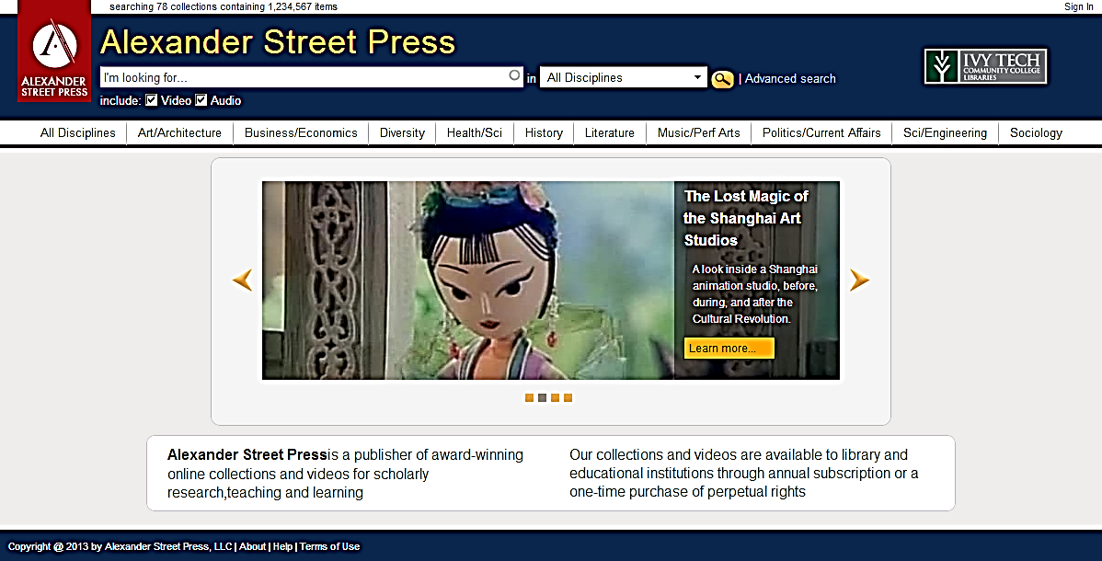
Start with all ASP content on one platform…
Unified, multi-database, multi-discipline cross-search
Preserving and opening controlled vocabularies
Single Open API for third-party access
Launched in July 2013

Slide 38
Inbound linking
Notes:
Can look at this two ways – inbound links

Slide 39
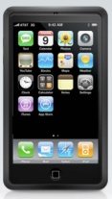

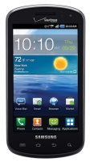
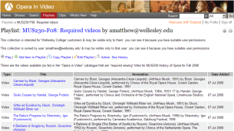


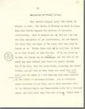




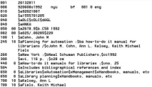
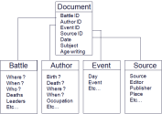
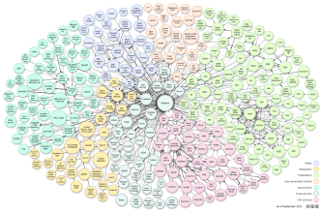
Inbound links
Mobile
Embeds
Search Engines
Discovery
Services
MARC
RDF
?
Notes:
Not there on RDF. We are publishing our ontologies, but we’re doing it discipline by discipline. Over time this will evolve.

Slide 40
Challenges to building semantic links
Philosophical issues
Many don’t want to link to ‘for fee’ objects
Charge for traffic generated or to generate traffic?
Building links is expensive. Who pays?
When things change who’s responsible?
Vested interests
Technical
Authentication
Permissions
Automated tools lacking

Slide 41
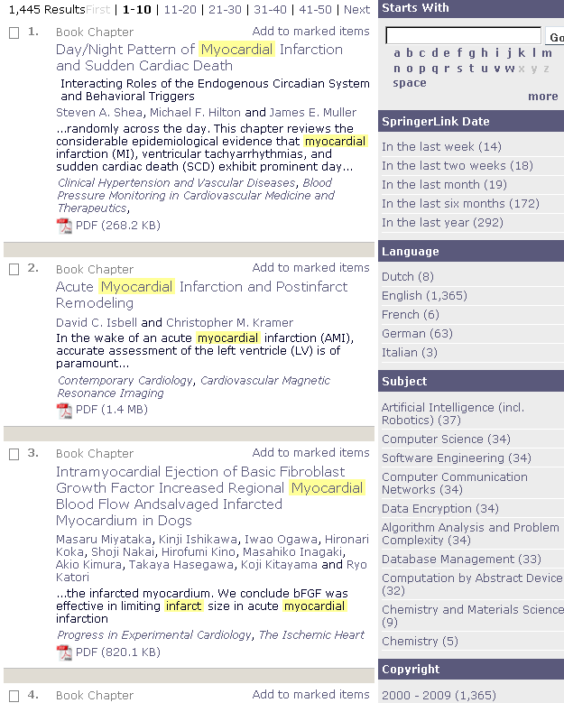



If the data isn’t there Not that useful Unhappy Students…
Notes:
You can see this in action…

Slide 42

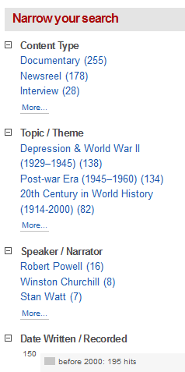
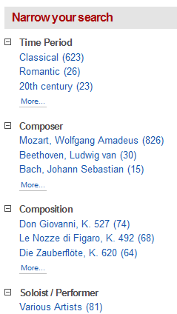
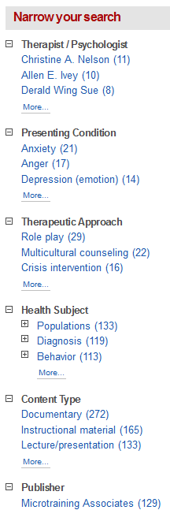
If the data is there…
3 search examples keyed into one box…
‘Churchill’
‘Mozart’
‘Child Therapy’
Notes:
We’ve made some good progress – because we have the underlying metadata…

Slide 43
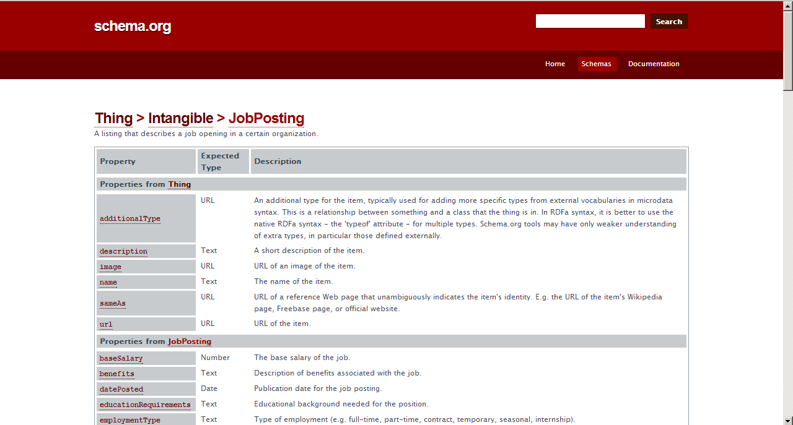
If the data’s there and the usage is there…
Notes:
If any of you are still wondering if this will be big take a look at this. This schema is being used by Google to crawl the web for job listings. If it were universally adopted we’d potentially be able to crawl every job listing instantly, by salary, by region, by qualification – automatically!

Slide 44
Outbound links

Slide 45
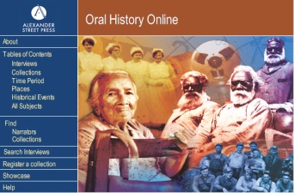

Experience so far
Oral History Online
Higher value links
Semantic indexing and keyword searching of more than 3,000 oral history collections
Represents the personal histories of some 300,000 people
Value:
Context
Selection
Search power
Licensed material
Integration

Slide 46
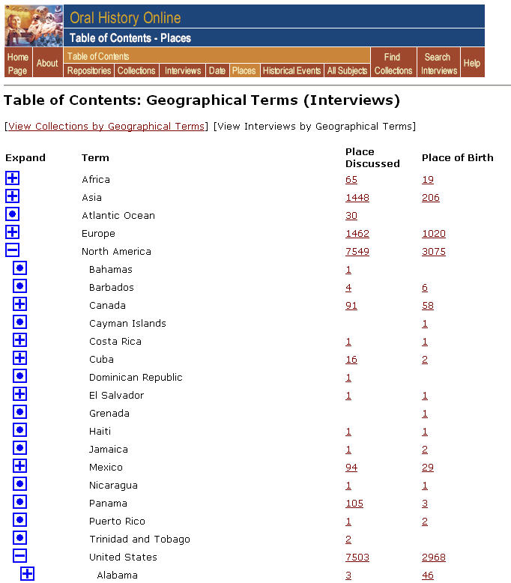
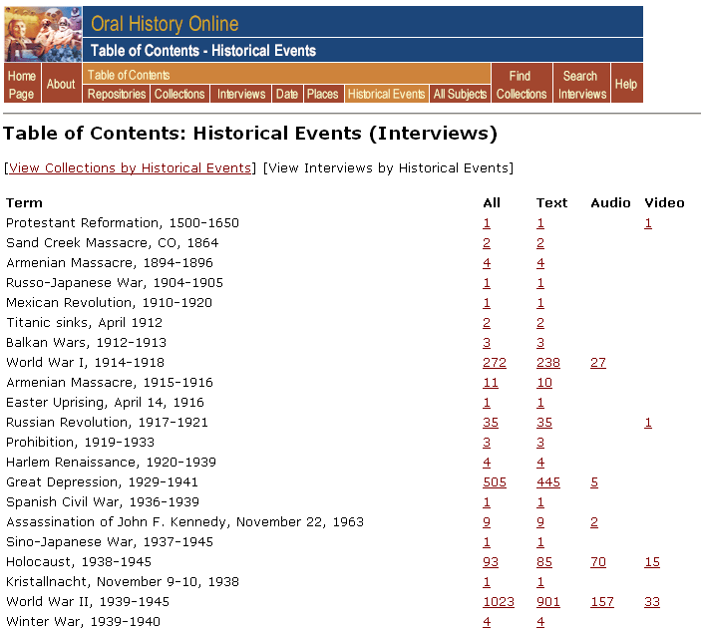
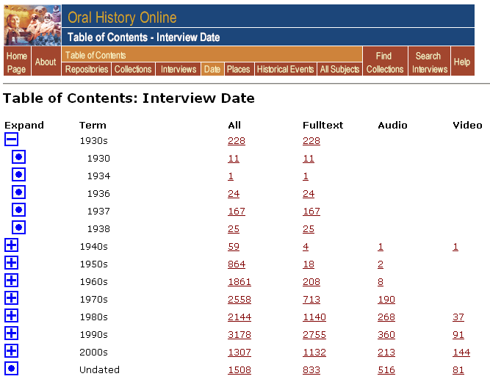
Browsing value…

Slide 47
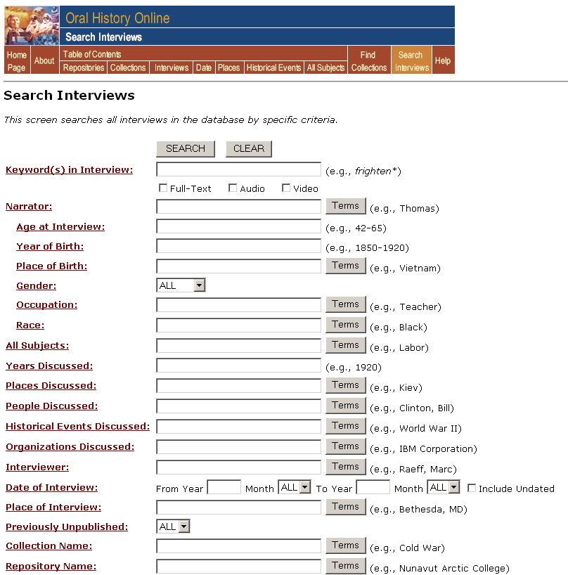
Search Power

Slide 48
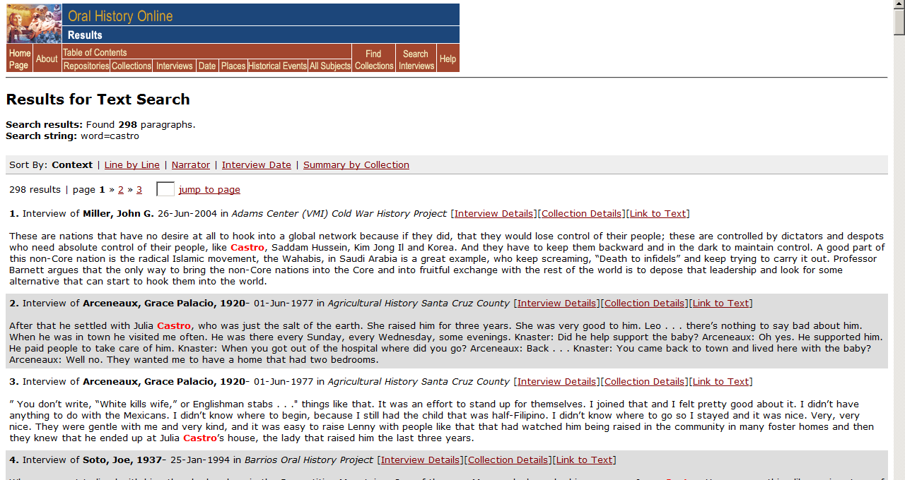
Context for results

Slide 49
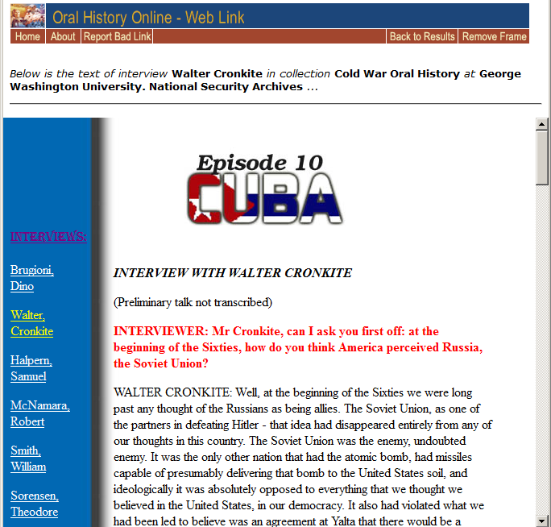
Done by linking alone

Slide 50
Challenge - Linking behaviors
Rather than… Do the following…
Change links constantly
Forbid others to link to you
Refuse to license for crawlers
Insist on one interface
Have permanent links
Invite others to link to you
Exchange links in batch through protocols like OpenURIs/URLs
Make citations visible to the outside world
If necessary charge for links/crawlers/APIs
Engineer for multiple interfaces
Ask others (e.g. Google) to do the same!
Notes:
Links are the backbone of the web. Links drive traffic. Links are the web’s form of citation.

Slide 51
Challenge - Library Perceptions
‘We want full-text content, not indexes’
‘Why should we pay for content that’s free?’
‘It’s not our job to index content we don’t own’
‘Should it be in the OPAC?’
Not sure what to do about MARC records…
Metrics and development funds prioritized towards
Content (look what we own)
Usage (look how much it’s being used)
Utility (look how much is learned/discovered)
Notes:
Discovery is only area where links have been monetized (and this is under pressure)

Slide 52
Business Issues
Who pays for the links?
Connections don’t lend themselves to advertising
Utility is largely in the background
OCLC aside, discovery services don’t pay for metadata
Permissions control is complex
Authentication
Determining ownership before providing access
Competitive forces
Major players (e.g. Google) won’t allow data mining
Discovery services

Slide 53
Room for improvement?
Feature | ASP | Discovery Service | Google
Quality content | Y | Y | N
Discipline relevance: comprehensive, covers rare, small sites | Y | N | N
Stability: automated re-directs and indicators of broken links | Y | Some | Some
Integration – playlist integration, easy citation, annotation. | Y | Some | Some
Usage statistics | Y | Y | N
Broken link user alerting | Y | ? | N
Deep integration of selected items – semantic indexing | Y | N | N

Slide 54

Adding discovery to Academic Video Online
Target Sites for Connectors
Source | # of Titles | What is it? | Level
C-Span | 400,000 | News broadcasts since 1983. | Cross-searched
TED Talks | 700 | Unique lectures | Cross-searched
WGBH Open Vault | 1,025 | Interviews with famous people | Title by title
Annenberg Media | 300 | Scientific Videos | Title by title
Science Cinema | 250 | Experimental Videos | Title by title
Civil Rights Movement | 125 | Oral Histories | Title by title
Total | 50 Sites, over 500k titles

Slide 55
Are publishers and librarians making progress quickly enough?

Slide 56
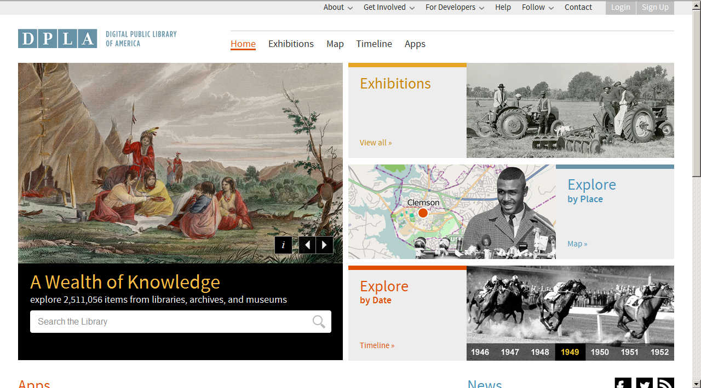
Some great sites…

Slide 57
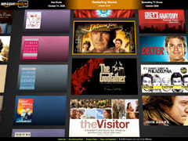



Too many Mash-ups to mention…

Slide 58


Growing number of targets…
Distribution of triples by domain
Distribution of links by domain
http://lod-cloud.net/state
Notes:
The number of RDF links refers to out-going links that are set from data sources within a domain to other data sources.

Slide 59

Freebase – entity definitions

Slide 60

Knowledge Graph Search for Singapore…
Google:– 715 million hits
Notes:
As of 8/11/13

Slide 61
Progress could be faster…
Semantic Web
Inference ‘knowledge’
Meaning based search
Automated Data interactions/Mash-ups
Discovery

Slide 62
Goes slower than you think…
Ted Nelson outlined Hypertext in 1963.
Berners-Lee wrote/published on a Hypertext project - The World Wide Web - in 1989/1990.
In 1999 Ted Nelson opined
“HTML is precisely what we were trying to PREVENT— ever-breaking links, links going outward only, quotes you can't follow to their origins, no version management, no rights management”
Notes:
Ted Nelson (1999). "Ted Nelson's Computer Paradigm Expressed as One-Liners". Retrieved July 3, 2011.
"Berners-Lee, Tim; Cailliau, Robert (12 November 1990). "WorldWideWeb: Proposal for a hypertexts Project". Retrieved 27 July 2009.

Slide 63
Where we’re headed
Why?
Therefore
Who, What, When, Where?
After Data, Information, Knowledge, and Wisdom, Gene Bellinger, Durval Castro, Anthony Mills. http://www.systems-thinking.org/

Slide 64

www.alexanderstreet.com

Slide 65

New ideas…
Nano-publication…
Notes:
http://www.slideshare.net/hvdsomp/towards-a-machineactionable-scholarly-communication-system

Slide 66

Nano-publication…
Notes:
Exploring the Generation and Integration of
Publishable Scientific Facts Using the Concept
of Nano-publications
Amanda Clare1,3, Samuel Croset2,3 (croset@ebi.ac.uk), Christoph
Grabmueller2,3, Senay Kafkas2,3, Maria Liakata1,2,3, Anika Oellrich2,3, and Dietrich
Rebholz-Schuhmann2,3
1 University of Aberystwyth
2 European Bioinformatics Institute
3 All authors contributed equally to this work
Abstract. Publication formats are being sought that facilitate automatic
processing and knowledge integration and are better suited to the
current pace of research. Here we present an infrastructure for producing
and consuming minimal publishable units, nano-publications, directly
from a researcher’s electronic notes or manuscripts which allow the integration
of multiple resources. We describe a feedback loop resulting from
the use of nano-publications, give a detailed example, and explain how
this can be combined with existing web technologies.

Slide 67
Elsevier’s Executable Article Challenge
Equations, tables and graphs interactive so reviewers, readers and machines can check, manipulate and explore the result space
Long term technical compatibility
Data and code validated easily and automatically
Balances author rights, institutional rights, and open access.
Registration and tracking of actions for provenance
Viruses and code contamination, plagiarism proof
Open API to enable automated queries by outsiders
Notes:
http://www.executablepapers.com/about-challenge.html

Slide 68

Utopia Suite – selected tools
Search Tool
PRECIS results with citations
3D Structure Tool
Sequences alignment editor
Notes:
Piotr Nowakowski, Eryk Ciepiela, Daniel Harężlak, Joanna Kocot, Marek Kasztelnik, Tomasz Bartyński, Jan Meizner, Grzegorz Dyk, Maciej Malawski, The Collage Authoring Environment, Procedia Computer Science, Volume 4, 2011, Pages 608-617, ISSN 1877-0509, http://dx.doi.org/10.1016/j.procs.2011.04.064.
(http://www.sciencedirect.com/science/article/pii/S1877050911001220)
Keywords: Executable paper; High performance computing; e-Science; Scientific publishing

