Slide 1

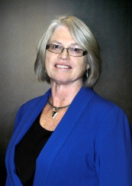
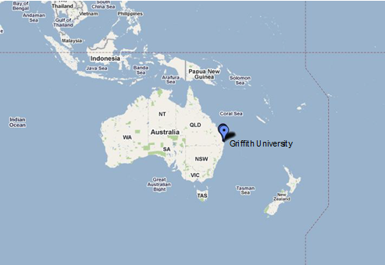
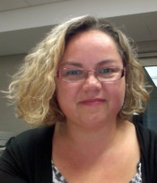
From Library to Research Hub
Connecting an Entire University Research Enterprise
Linda O’Brien
Pro Vice Chancellor (Information Services)
Natasha Simons
Senior Project Manager (Information Services)
Griffith University
Brisbane, Queensland, AUSTRALIA
15th Fiesole Collection Development Retreat
Singapore, August 12-14, 2013
Notes:
Speaker introductions
Topic introduction

Slide 2

a community of scholars
The University
  A place whither students come from every quarter for every kind of knowledge...a place for the communication and circulation of thought, by means of personal intercourse…where inquiry is pushed forward...discoveries verified and perfected...error exposed, by the collision of mind with mind, and knowledge with knowledge
John Henry Newman, The idea of a university. 1852
Notes:
I have always been taken by the idea of the university as a community of scholars – dates back to 1852 JHN
About knowledge – its communication, circulation, about challenging knowledge through exposure and debate, about creating new knowledge - research

Slide 3

The Library
The libraries and museums of the nation hold, and provide access to, the archives and collections that tell us about what we are and where we have come from. They are the traditional repositories of human wisdom and knowledge.
Librarians are both the guardians of the record and key figures among the keepers of the gates of knowledge.
Professor Peter Doherty; The 2004 Keith Murdoch Oration Knowledge in the information age. SLV
Notes:
Libraries were seen as the repositories of that knowledge with librarians the guardians of the record
Not hard to see why the library was regarded as the heart of the university, as still evidenced by often their central locations on a campus

Slide 4


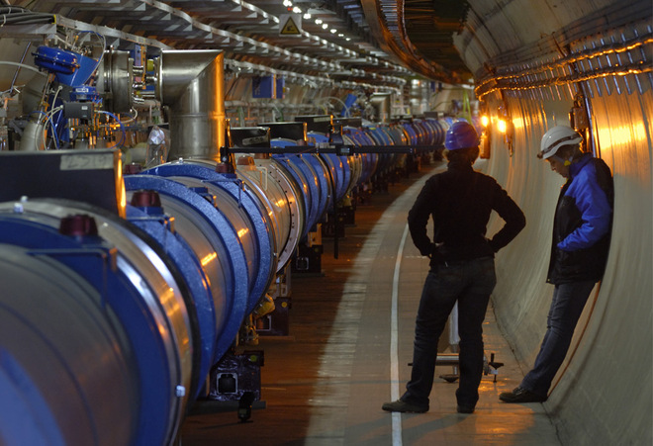
A changing knowledge environment
Rapid technological change
Global competition and collaboration
Significant increase in digital information and research outputs much more than publications
Research funding bodies seeking better return on investments
Shift to better manage ever-increasing volumes of research data and to view data as a first class output of research.
Image credit: http://theconversation.com/australias-bid-for-the-square-kilometre-array-an-insiders-perspective-4891
Image credit: http://www.globalresearch.ca/the-bilderberg-plan-for-2009-remaking-the-global-political-economy/13738
Image credit: http://www.wired.com/wiredscience/2008/09/the-bosons-that/
Notes:
A global community of scholars, connected, collaborating and competing
Rise of rankings
Outputs much more than publication
Increasingly digital
So what does this mean for the role of the library as the traditional repository of human Knowledge? Of the librarian as the “guradian of the record”?

Slide 5

The Library
The role of libraries… will shift from primarily acquiring published scholarship to a broader role of managing scholarship in collaboration with the researchers that develop and draw upon it.
Clifford Lynch in Libraries and changing research practices: a report of the ARL/CNI Forum on E-research and cyberinfrastructure http://www.cni.org/wp-content/uploads/2010/11/arl-br-237.pdf
Notes:
…as that “record” is increasingly digital whilst this challenges the notion of the “library as a place” yet it exacerbates the need for the librarian to be a “guardian of the record” – to manage scholarship in collaboration with researchers…
Now a bit about the national and local context…
The Griffith Research Hub is a manifestation of our commitment to ensuring the Library contributes in a very real way to the re-invigoration of the community of scholars in an increasingly digital global knowledge economy

Slide 6
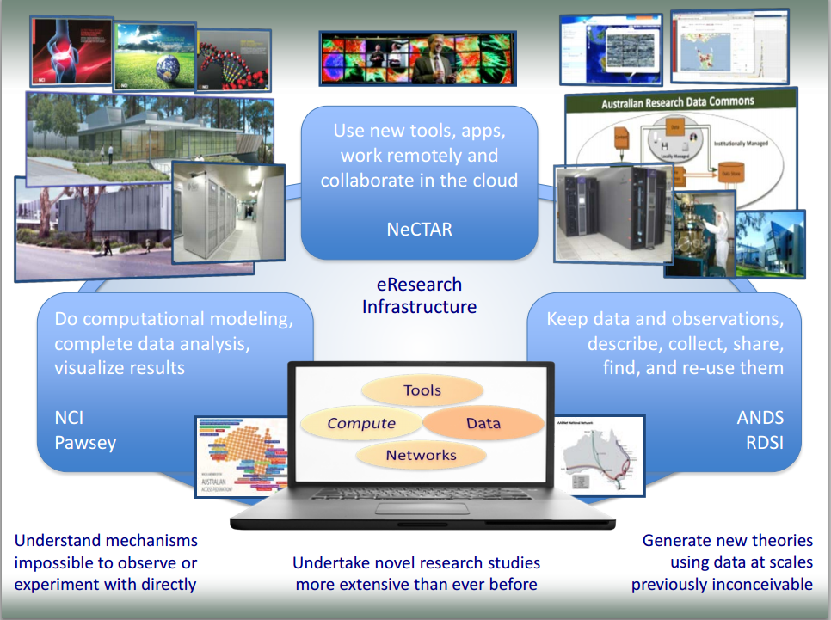
The Australian Research Context
Rhys Francis, Australian eResearch Infrastructure: advancing discovery in an information rich world http://eresearchau.files.wordpress.com/2012/11/03_rhys_francis.pdf

Slide 7
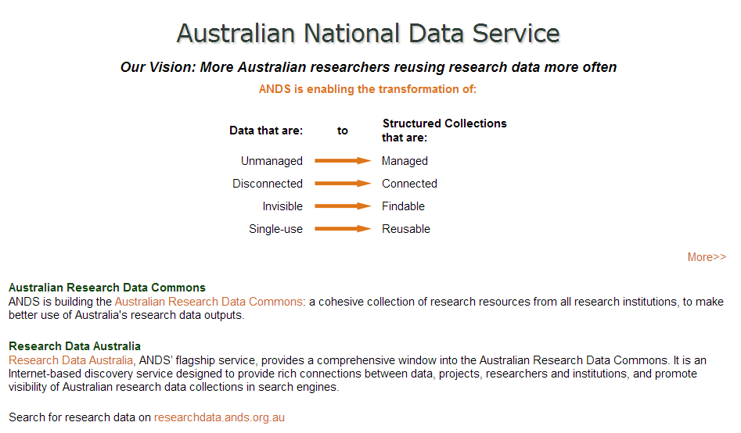
http://www.ands.org.au/index.html
http://www.ands.org.au/index.html
Notes:
And about Griffith University

Slide 8
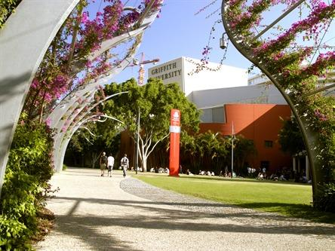
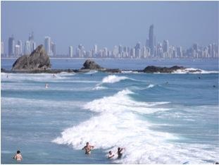
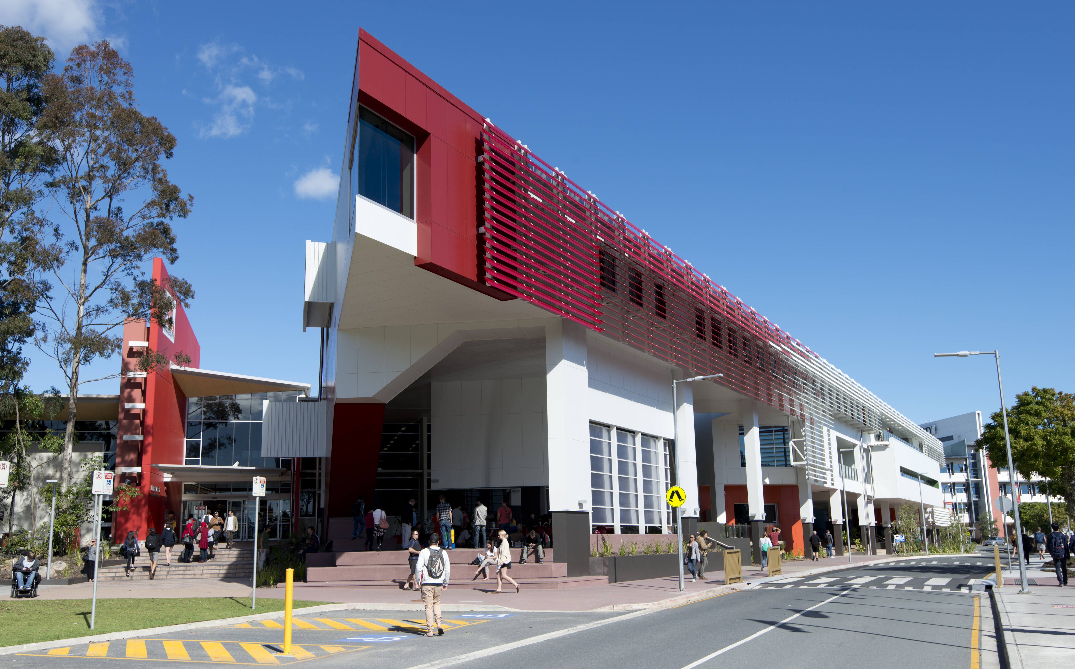
Griffith’s vision is to be one of the most influential universities in Australia and the Asia-Pacific region.
43 000 students and > 20% international
300+ degrees and 2500+ researchers
5 main campuses + online programs
In top 5% of universities worldwide
In Times HE top 100 universities under
50 years old (2013)
Notes:
Campuses range from the Arts precinct at Brisbane’s Southbank to a campus in Logan City to the largest campus at Gold Coast 70 kms away
About the only major discipline not covered is veterinary sciences
Established 1975
40 000 students from 124 countries
40 research centres
Top 5 % of the World’s universities The Times HES – QS World Universities Rankings 2010
Founding ethos cross disciplinary research, sustainability and social inclusion
The Excellence in Research for Australia (ERA) 2012 results (based on the 2005-2010 period) profile Griffith as a comprehensive, research-active university with approximately 88% of eligible researchers associated with broad (two-digit) fields of research assessed at world standard or better.

Slide 9
Griffith University Research Objectives 2013-2017
Consolidate world-class research strength through our selected Areas of Strategic Investment
Demonstrate research of international standing in all our discipline areas as recognised by ERA (Excellence in Research for Australia) and other international ranking metrics
Maintain a culture of research quality and performance that is well supported by infrastructure (physical and electronic) and resources (financial and human)
Maintain our core commitments as a university to innovation, bringing disciplines together, and undertaking socially relevant research which provides demonstrable community benefit.
Notes:
Demonstrate
Innovation
Bringing disciplines together
Socially relevant
Community benefit

Slide 10
Information Services
Information Services enables the creation, synthesis and dissemination of knowledge within a global information environment. Our services are interwoven into all aspects of the University's business. We achieve this by understanding the needs of the University community, collaborating with our colleagues across the University and beyond, and providing leadership in our areas of expertise. Our success is founded on a strong service ethic and a culture that values innovation and diversity, strengthened through our integrated service model.
Notes:
Point out synergies with role of university and of a library
Refer to Information Management Framework handout – one pager with information domains on the back
Hence an holistic approach to information management….which Natasha will now demsontrate in action

Slide 11
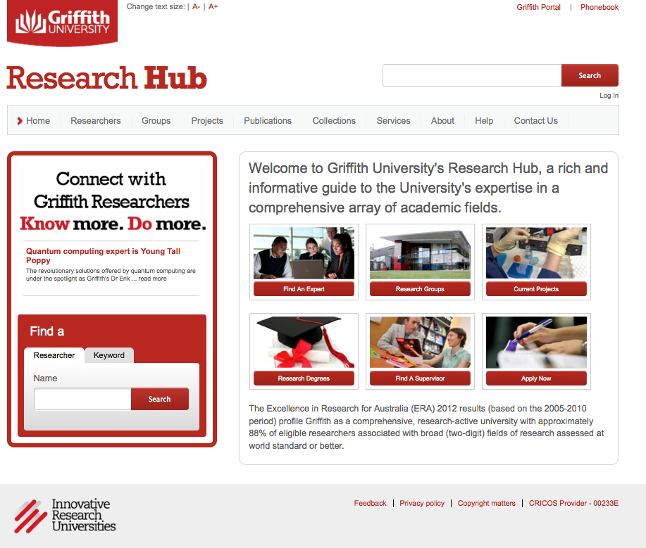
http://www.research-hub.griffith.edu.au/
Notes:
The RH is described on its home page as “a rich and informative guide to the University’s expertise in a comprehensive array of academic fields”. It was built in-house at Griffith and officially launched in June 2012.
The Hub serves as a showcase for Griffith research and contains profile pages of Griffith researchers and their associated groups and research centres, their projects and grants, their publications, their research data collections, and a small number of services e.g. smart meter information portal.
There is also an “about” page and some FAQs on a “help” page.
You can find the Hub by typing the home page URL into your web browser or via the Griffith home page, research menu, or you can find it via a Google search.

Slide 12
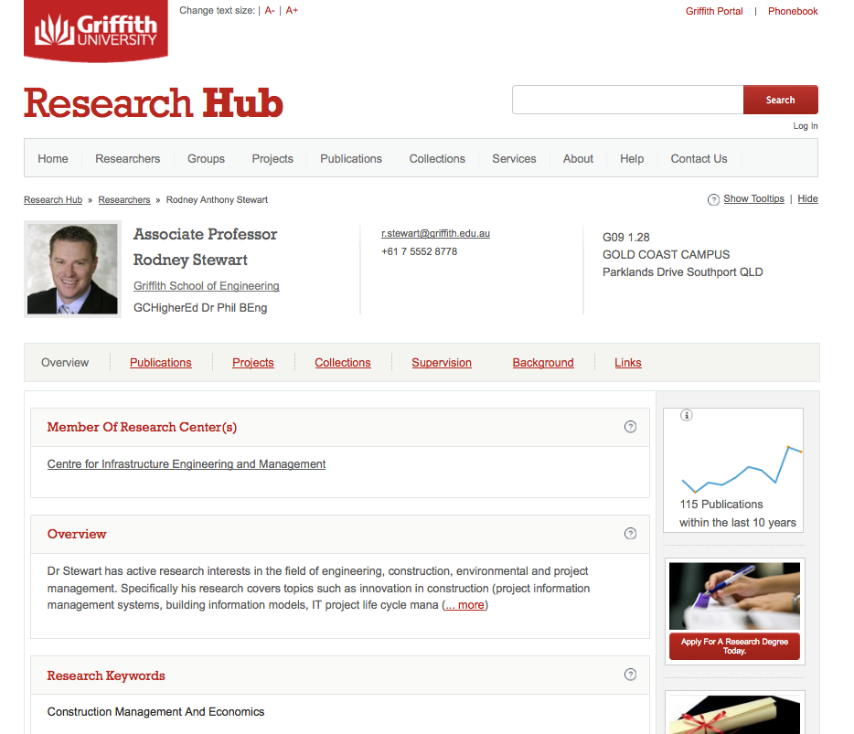
Notes:
This screenshot shows the Hub profile page for Assoc Prof Rodney Stewart. It contains his photo, position title, school affiliation and contact details at the top. Then there are a number of tabs. The overview tab includes a short biographical statement, research areas (free text and field of research codes). The publications tab includes his publications, divided into publication types and then ordered by year, his projects and grants, his data collections, his supervisory experience (HDR students and the theses they have produced). There is a background tab which includes a wide variety of information from his tertiary qualifications through to awards and internships. Finally, the links tab includes links to other websites related to Rodney’s profile – in his case his Google Scholar Citations page, among other links.
It’s important to note that while all publications and projects are discoverable through the Hub, not all Griffith researchers have a profile page in the Hub. Those that do, have met the criteria of 6 publications over the last 6 years or equivalent as per government reporting eligibility. Inclusion is calculated automatically based on publications that have been entered into the My Pubs portal. The idea behind this rule is to ensure that researchers who have profile pages in the Hub can be shown with a significant number of research publications, grants and so forth.

Slide 13
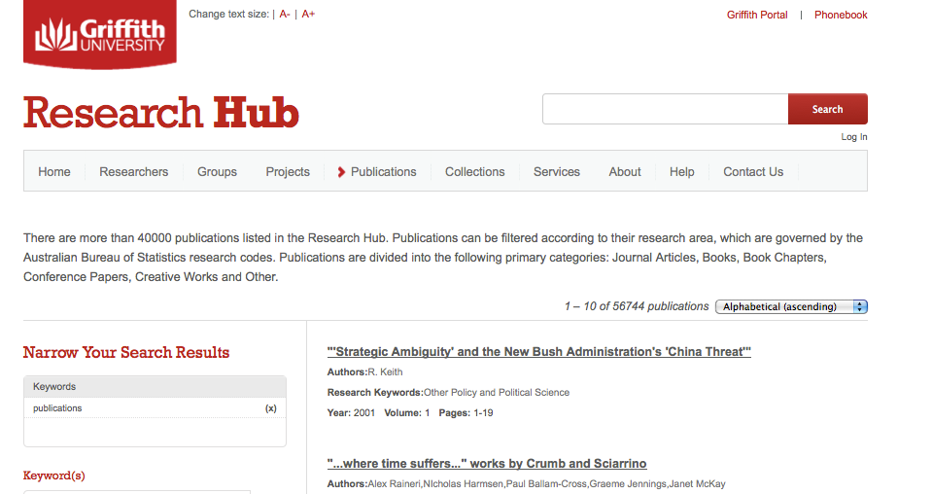
The Hub contains:
1065 researcher profile pages
65 groups
5778 projects
56, 744 publications
58 research data collections
12 services
Notes:
The Hub contains:
1065 researcher profile pages
65 groups
5778 projects
56, 744 publications
58 research data collections
12 services
You can find out the most up to date statistics by simply clicking on each of the tabs in the Hub, as the screenshot demonstrates.

Slide 14
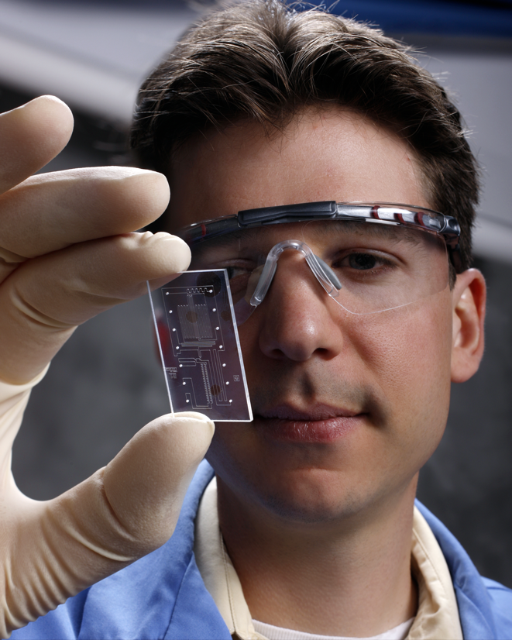
What is the Research Hub audience?
People using the Hub include:
HDRs looking for supervisors.
Researchers looking for sources of information and potential collaborators.
Journalists looking for expert sources of information.
Industry looking for consultancy expertise.
These are just a few of the audience segments that have a critical need for a single, comprehensive view of the university’s research output.
Notes:
[Image credit: https://share.sandia.gov/news/resources/releases/2008/MICA.html]
The Hub serves an ambitiously wide audience. This includes:
HDRs looking for supervisors.
Researchers looking for sources of information and potential collaborators.
Journalists looking for expert sources of information.
Industry looking for consultancy expertise.
The Hub replaces both Research Experts and Media Experts.

Slide 15

Research Hub statistics
1 July 2012 to 30 June 2013 (12 months):
267, 000 page views.
62, 211 site visits.
4.3 pages viewed per visit.
45, 500 unique visitors. Of the visitors:
83% of visits came from outside the Griffith University network.
    40% from countries other than Australia.
    300 researchers logged in to the Hub update their profile pages.
186 requests received via the ‘contact us’ form on the Hub website.
Notes:
[Image credit: http://web.lmi.org/gme/Welcome.htm]
These are the Hub statistics for 1 July 2012 to 30 June 2013 (12 months) and show in numerical terms how effective the Hub has been in reaching its wide audience.
267, 000 page views.
62, 211 site visits.
4.3 pages viewed per visit.
45, 500 unique visitors. Of the visitors: 83% of visits came from outside the Griffith University network. 40% from countries other than Australia. The top six in descending order: USA, UK, India, China, Iran, Malaysia.
300 researchers logged in to the Hub update their profile pages. eResearch Services staff and administrative staff from various schools have updated many more Hub profile pages.
186 requests received via the ‘contact us’ form on the Hub website (Mostly HDRs and researchers – help in finding a collaborator or updating their profile page).

Slide 16
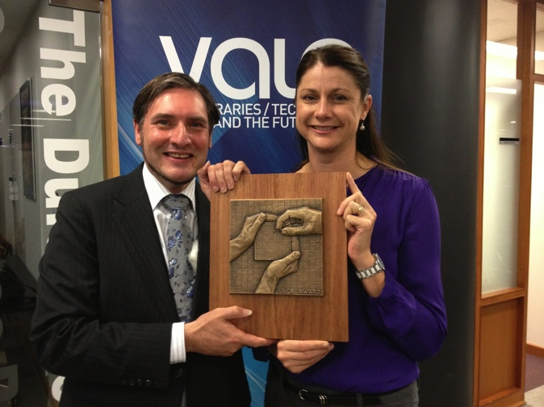
Research Hub awards
VALA Award 2012
Commendation of Merit in the Stanford Prize for Innovation in Research Libraries 2013
“Griffith University has no traditional library as such, and so they are in a position to concentrate on innovation. Their research hub project is a visionary integration of the entire research output of the university, in all formats, made discoverable and accessible for the whole world. Every kind of research institution will move to doing something like this very soon: their model is inspiring”.
– Ann Okerson, Senior Advisor on Electronic Strategies, Center for Research Libraries
[from judges comments, Stanford Prize for Innovation in Research Libraries]
Notes:
The achievements of the Hub as a technological innovation filling the need for a single comprehensive view of the university’s research output has been recignised in two prestigious awards:
The VALA Award 2012
Commendation of Merit in the Stanford Prize for Innovation in Research Libraries 2013
Worth reading the judges comments from the Stanford Award. Ann Okerson, Senior Advisor on Electronic Strategies, Center for Research Libraries, said that:
“Griffith University has no traditional library as such, and so they are in a position to concentrate on innovation. Their research hub project is a visionary integration of the entire research output of the university, in all formats, made discoverable and accessible for the whole world. Every kind of research institution will move to doing something like this very soon: their model is inspiring”.

Slide 17
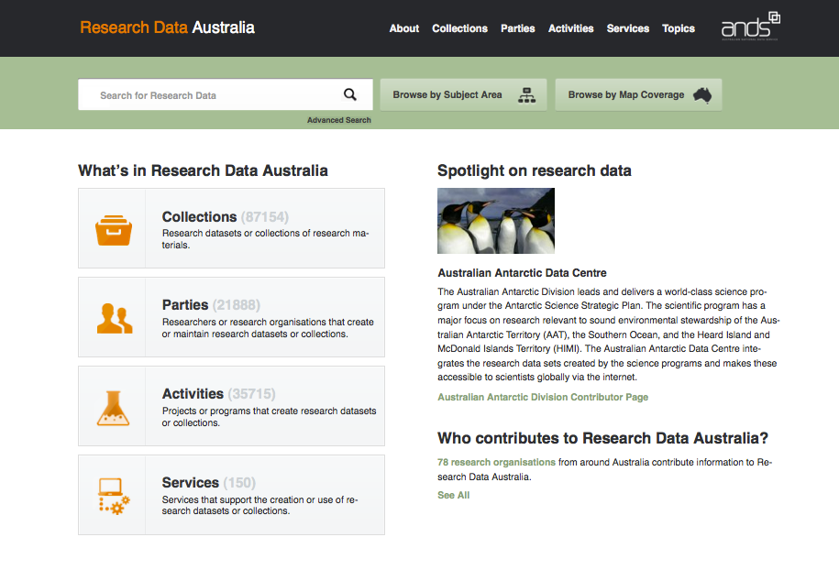
Who developed the Research Hub?
The ANDS Research Data Australia portal - http://researchdata.ands.org.au/
Notes:
The initial funding from ANDS came under their metadata store program. This goal of this program is to provide institutions with funding to develop a central system or service which can house information relating to research data collections – such as research data collection descriptions and access points, and connections to the researchers and groups who own the collections. Information from this “metadata store” – which refers to the descriptions and not storage of the data itself (which is done by another system such as a repository) – is then provided to the ANDS Research Data Australia web portal. The RDA portal is designed to expose and showcase collections of research data contributed by Australian research institutions from university’s to the CSIRO.
So, initial funding from ANDS allowed us to develop this “metadata store” and feed to the information to RDA. The development work could have ended there. However, at Griffith we saw the money from ANDS as a leg up rather than a hand out. We saw the potential to develop the metadata store – which was built on vivo software from Cornell University – into a full blown researcher profile system that could showcase our researchers and their research outputs.

Slide 18

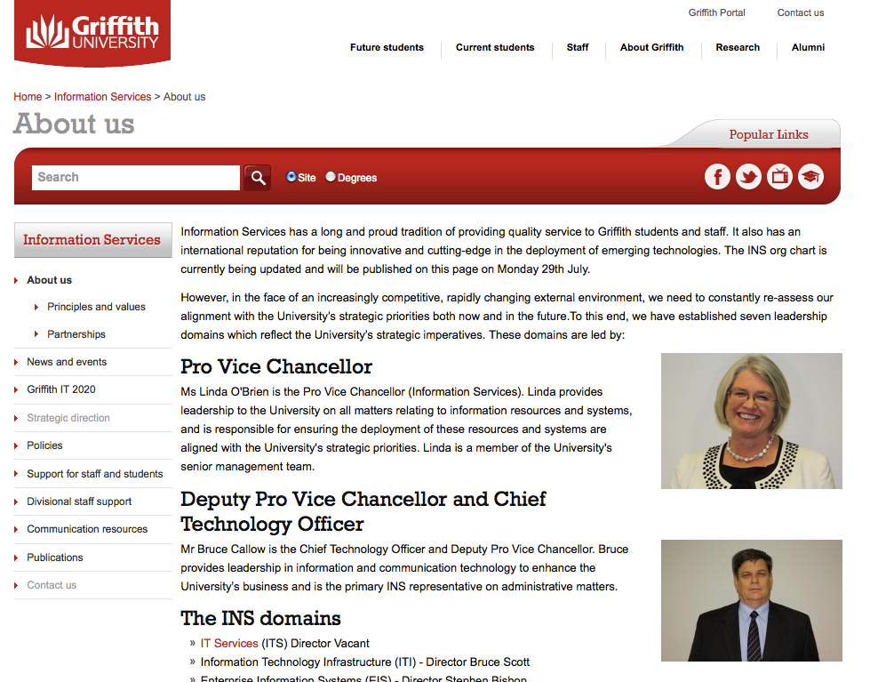
Who developed the Research Hub?
Further funding provided through internal Griffith grant
Griffith University partnership between:
Office for Research (OR) – business owner
Division of Information Services (INS) – service provider
Notes:
So began a very fruitful partnership between the Office for Research (OR) – business owner of the Hub – and the Division of Information Services (INS) – service provider of the Hub. Further funding to develop the Hub was sourced through an internal Griffith grant and a project board was formed. The Board was chaired by Dr Vicki Pattemore, Director, Office for Research and other members were Ms Linda O’Brien – INS, Mr Steve Bishop – ICTS, Prof. Sue Berners-Price – GGRS, Jo Morris – INS.

Slide 19
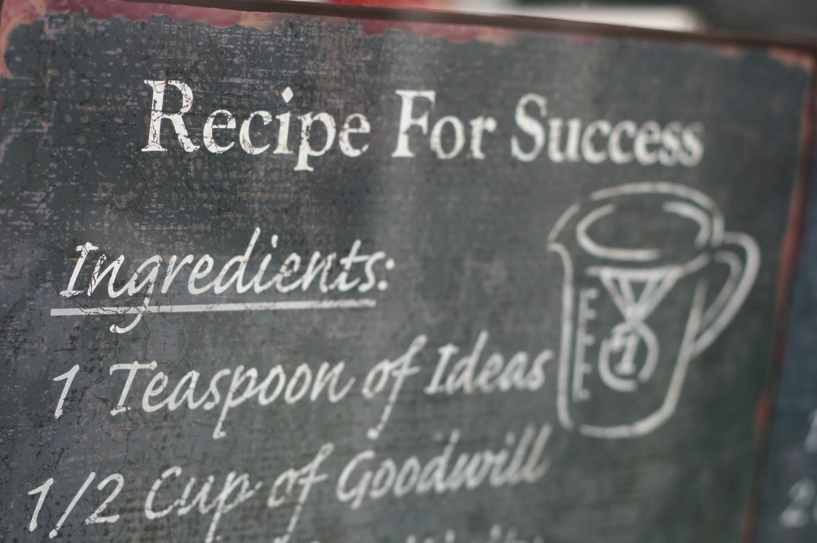

Who developed the Research Hub?
Recipe for a successful partnership:
A demonstrator model.
Extending on initial funding from ANDS.
A shared vision.
A highly motivated, talented technical team.
Flexible thinking.
Taking a leadership role.
A spirit of innovation and experimentation.
Notes:
[Image credit: http://free-images-etc.rb-d.com/?p=3046]
What factors made the partnership successful? This is my list, and Vicki may have her own.
A demonstrator model (Cornell) and the base built through the initial funding from ANDS
A shared vision (even if differences in implementation)
Clear definition of roles and division of labour within the Project Board
A highly motivated and very talented technical team
A spirit of innovation and experimentation that encouraged flexible thinking within the project team and the board
Flexible thinking
Clear communication – verbal and written – including a willingness to really listen to each other
Taking a leadership role nationally (ANDS describes the Hub as a “beacon of light” for other organisations) and internationally (this is borne out in the judges comments for the Stanford prize and in our respect among with VIVO software community).

Slide 20
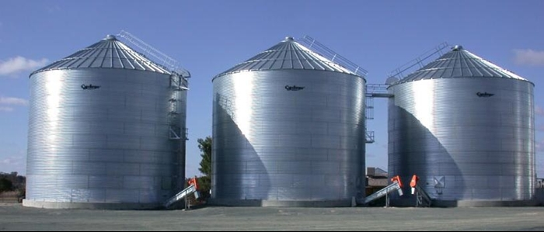
How does the Research Hub work?
Information silos make it hard for researchers to find what they need
Griffith Research Online publications repository
Griffith Research Data repository
Griffith theses repository
Griffith HR database
Research Administration Database
Media Experts
Research Experts
Staff profile pages
Notes:
[Image credit: Image source: http://www.onesteelcyclone.com.au/silos]
How does the Research Hub work?
(read from slide)

Slide 21
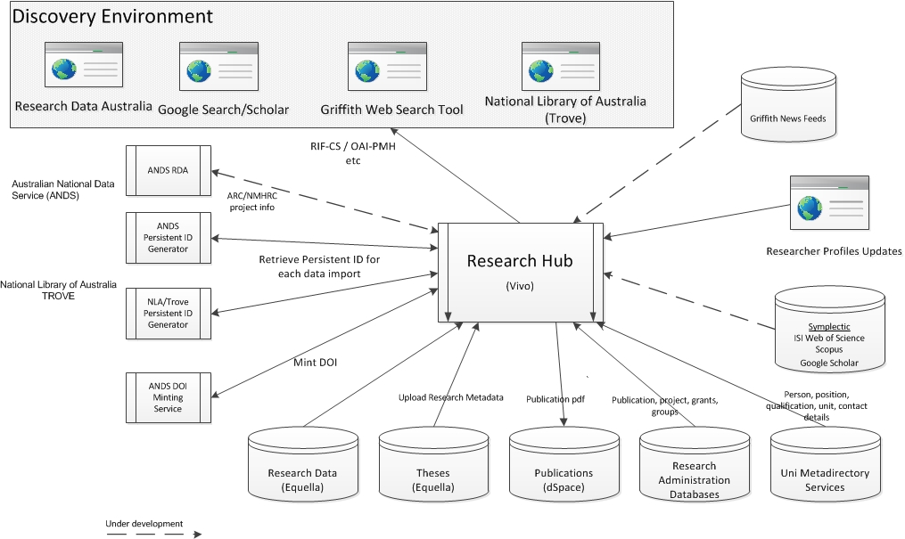
How does the Research Hub work?
.
Notes:
Hub draws data automatically from various information silos within the university and connects that information for discovery and re-use.
Automatic nightly ingest of data from:
Research Administration Database (publications, grants/projects, groups).
Metadirectory
(names, positions, qualifications, contact details).
Research data repository
(data collections).
Theses repository
(Griffith HDR theses).
Data from the Hub is output to:
Google.
Trove (National Library of Australia).
Research Data Australia (ANDS).
Research Data Self Service (in the future)

Slide 22
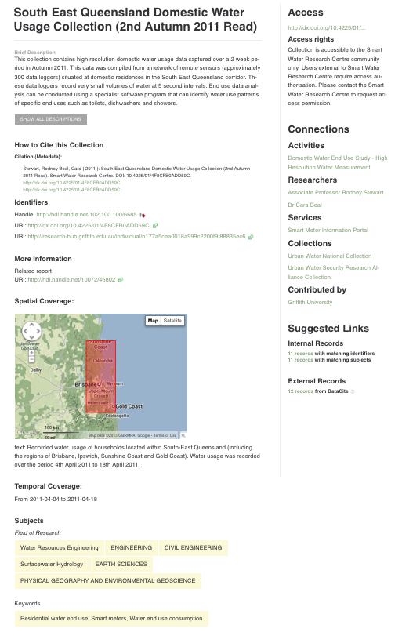
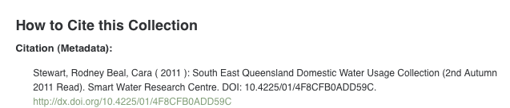
How does the Research Hub work?
Research data collection records are harvested from the Hub into Research Data Australia.
Enhanced ‘Gold Standard’ metadata for data collections is provided in RIF-CS.
Notes:
Research data collection records are harvested from the Hub by ANDS into Research Data Australia.
Enhanced ‘Gold Standard’ metadata for data collections is provided in RIF-CS format (mapped from the Hub’s RDF).
Rich metadata facilitates:
Discovery
Access, use and reuse
Data citation (includes DOIs for data collections minted by Griffith through the ANDS ‘Cite My Data’ service)
Use of spatial and temporal widgets and tools.
Gold Standard project blog:
http://ands-gold-griffith.blogspot.com.au/
D-Lib article on DOIs: http://dx.doi.org/10.1045/may2012-simons

Slide 23
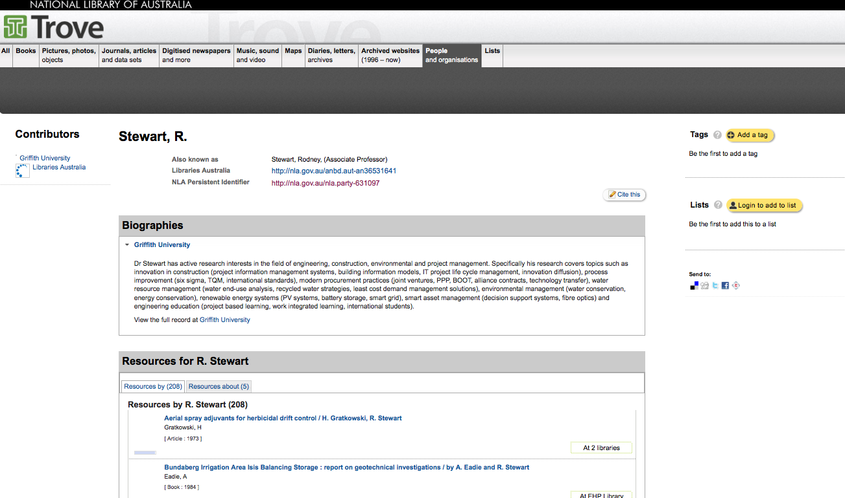
How does the Research Hub work?
Party records are harvested from the Hub into the National Library of Australia’s Trove service.
Notes:
People and group records (‘party records’) are harvested from the Hub by the National Library of Australia which issues the record with an ‘NLA persistent identifier’ and displays the record in the Trove ‘People and Organisations’ zone.
Trove also contains research data collections from the Hub via a harvest feed from ANDS.

Slide 24

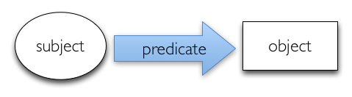
How does the Research Hub work?
VIVO is an open source semantic web application originally developed in 2004 at Cornell University. It enables the discovery of research and scholarship across disciplines at that institution and beyond.
RDF Triple Store
Example: This researcher (name) – is owner of – this research data collection
Notes:
The Hub is built on VIVO software.
VIVO is an exciting software application used by institutions of higher education and research which empowers them to share information and discover opportunities for collaboration.
VIVO is an open source semantic web application originally developed in 2004 at Cornell University. It enables the discovery of research and scholarship across disciplines at that institution and beyond.
VIVO Board and conference
Explain triples
Important thing is the relationships between things. The Hub contains over 5 million triples!

Slide 25
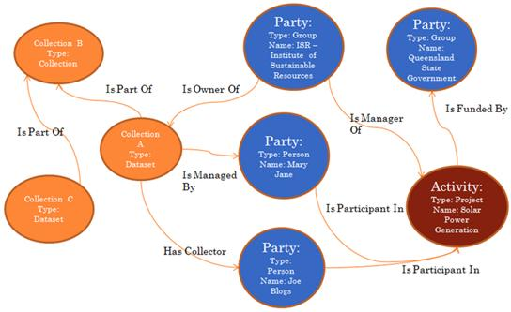
How does the Research Hub work?
The Hub uses the ANDS-VITRO ontology: http://purl.org/ands/ontologies/vivo/
Griffith University has made all VIVO customisations available as open source code: https://github.com/gu-eresearch/VIVO
Notes:
The Hub uses the ANDS-VITRO ontology (and customised local additions):
The VIVO Ontology was extended to cover research data sets, as well as the vocabulary and structure required by ANDS (RIF-CS schema) .
Ontology development was a collaboration between Griffith University, QUT, and Melbourne University.
The ontology can be found at: http://purl.org/ands/ontologies/vivo/
Griffith University has made all VIVO customisations available as open source code: https://github.com/gu-eresearch/VIVO

Slide 26
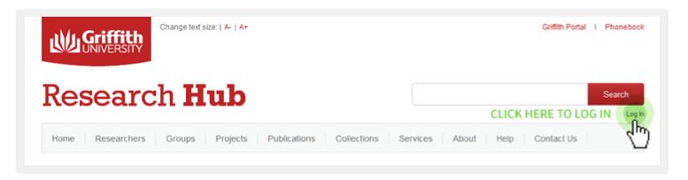
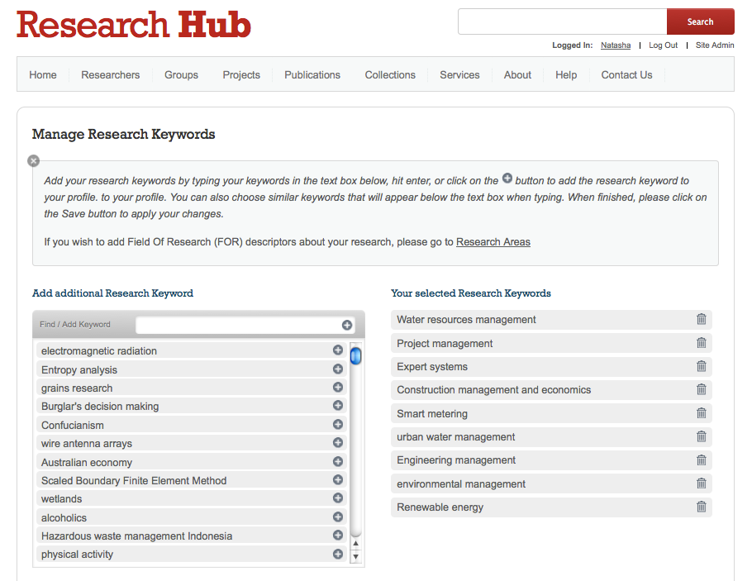
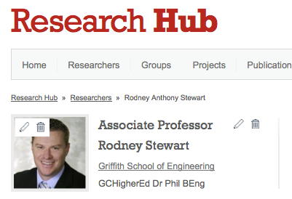
How does the Research Hub work?
The Research Hub is a self-edit model
Notes:
The Hub is also a self-edit model that allows researchers to login and update, add or delete information in their profile.
Reason – not all data in source systems is correct.
Model:
Where incorrect, fix in source wherever possible. Otherwise, fix in hub.
Can also enhance your profile e.g. free text keywords for research areas.
No obligation for researchers to login and update their profiles.

Slide 27
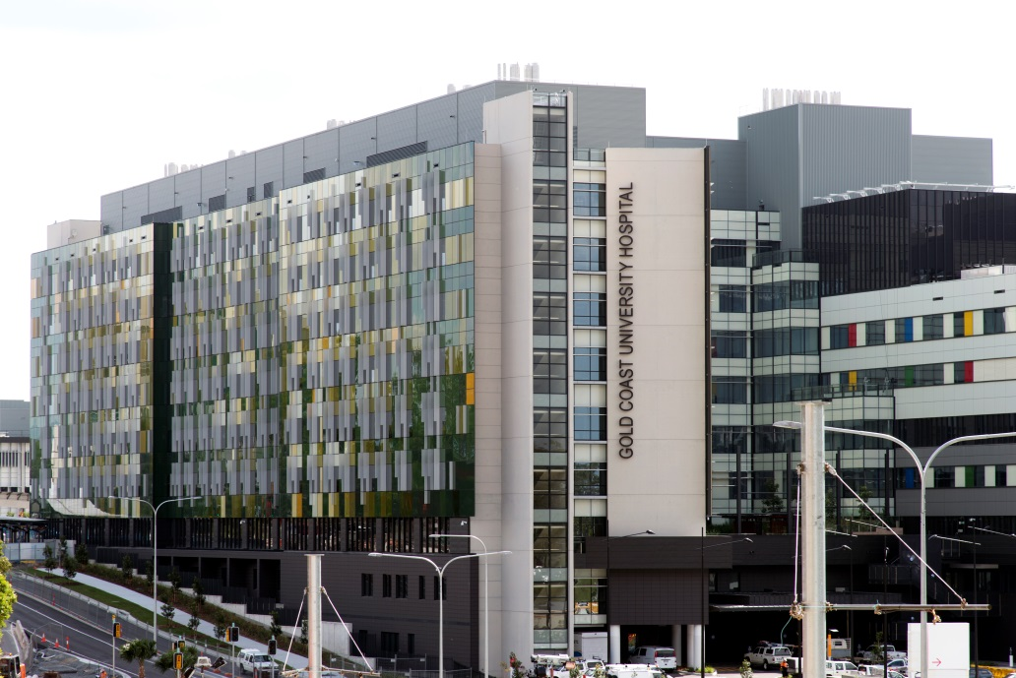
What is the value in the Hub?
Direct alignment with the vision of Griffith University, INS and ANDS.
A single, comprehensive view of the university’s research outputs.
Showcase for Griffith researchers.
Substantial web traffic.
Enter data once, use many times.
Development of an ontology for research shared nationally and internationally.
Notes:
There are many benefits.
Direct alignment with:
Griffith University’s vision to be a university of influence.
Griffith University’s Division of Information Services vision of enabling the creation, synthesis and dissemination of knowledge within a global information environment.
Australian National Data Service’s vision of ‘more Australian researchers reusing research data more often’.
A single, comprehensive view of the university’s research outputs.
Showcase for Griffith researchers.
Attracts substantial web traffic.
Enter data once, use many times.
Automatically makes explicit the links between data, researchers, their publications, projects and research group affiliations.
Totally automated ingests from source systems across the university.
Serves an ambitiously wide audience.
Development of an ontology for research shared nationally and internationally.

Slide 28

What challenges has the project team faced?
Research Hub project challenges:
Early implementers of VIVO.
Reaching agreement with various data owners.
Getting support from stakeholders
Impact of exposure of information never before made public.
Impact of the self-edit model.
Impact of rules on who gets a profile page.
Lessons learned:
Post project support and in-kind contributions required.
Ongoing support model should involve IT staff and librarians.
Getting support from Office for Research & researchers is critical.
Notes:
[Image source: http://www.activegarage.com/project-reality-check-1-challenge]
Research Hub project challenges:
Early implementers of VIVO.
Reaching agreement with various data owners.
Getting support from stakeholders (esp. Office for Research).
Navigating policy and privacy issues.
Research data management and storage.
Technical complexity.
Managing scope creep.
Impact of exposure of information never before made public.
Impact of the self-edit model.
Impact of rules on who gets a profile page.
Lessons learned:
Post project support and in-kind contributions required.
Ongoing support model should involve IT staff and librarians.
Getting support from Office for Research & Researchers is critical.

Slide 29
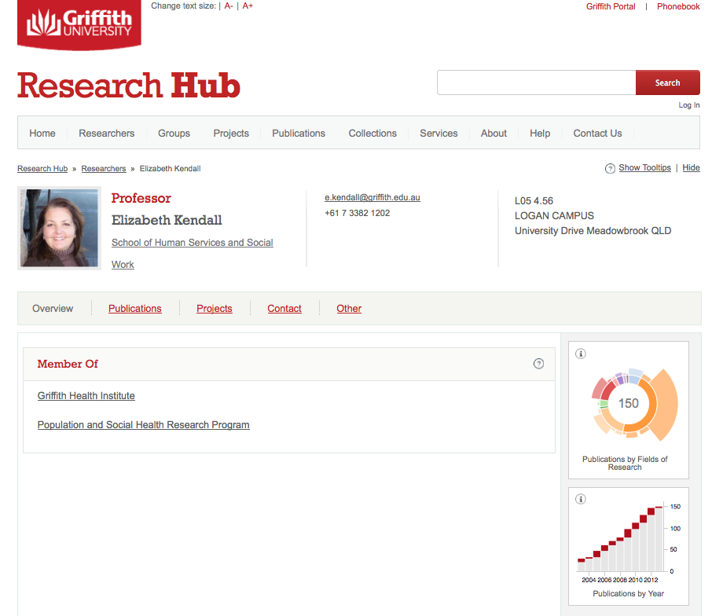
What are the plans for the Research Hub ?
Notes:
Replace graph.

Slide 30
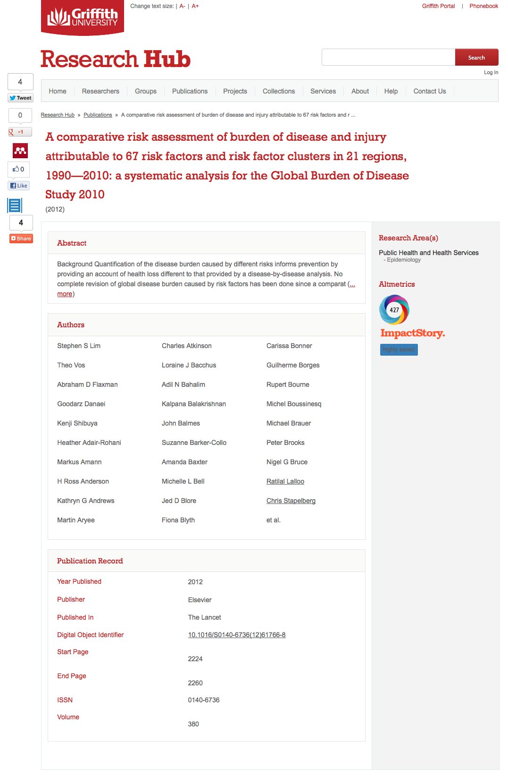


What are the plans for the Research Hub ?
Citation metrics and altmetrics at the article level (via integration with Symplectic)
Buttons to share, tweet etc.

Slide 31

What are the plans for the Research Hub ?
Complete transition to ongoing support model.
Ingest NHMRC and ARC grants data (via ANDS).
Ingest of news data.
Integration with Symplectic (metrics)
Increase coverage to include all Griffith academics, higher degree research students
and key research collaborators
Increase scope to include all scholarly outputs including “grey literature”, teaching objects
Notes:
(read from slide)

Slide 32

We’ve started the story but we haven’t yet written the ending…
A story of re-inventing the library as
“the guardian of the record”
and re-invigorating the concept of the university as a community of scholars in an increasingly digital global knowledge economy
Notes:
Griffith is an international innovator in information and technology in order to deliver Griffith's vision as a university of influence
We take an holistic view of information and technology management
We view the opportunities delivered through emerging policy change (open) and technologies (semantic web) as a great opportunity to reinvigorate the concept of a global community of scholars - underscoring the critical importance of partnerships in building community.
The Griffith Research Hub is a manifestation of our commitment to ensuring the Library contributes in a very real way to the re-invigoration of the community of scholars in an increasingly digital global knowledge economy
I believe that technological change now breathes new life into this concept – providing the opportunity to create a global community of scholars

Slide 33
Questions?

