Slide 1
Open Access in Asia
Nobuko Miyairi
Consultant/Analyst, Asia-Pacific
Nature Publishing Group
n.miyairi@nature.com
15th Fiesole Collection Development Retreat
August 13, 2013

Slide 2
OA mandate is still a long way to go in Asia.

Slide 3
OA mandate status
Advanced Search ROARMAP: Registry of Open Access Repositories Mandatory Archiving Policies
http://roarmap.eprints.org/

Slide 4
Publishers in Asia are actively publishing OA journals.

Slide 5
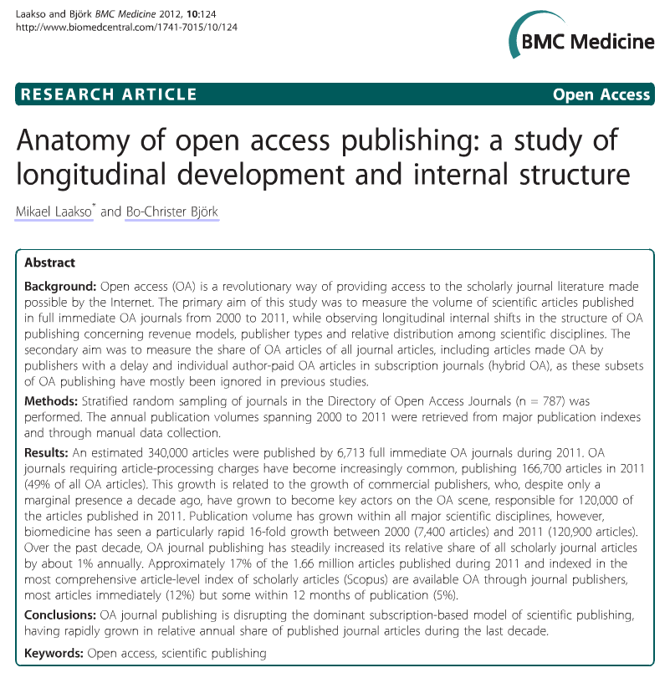

Slide 6
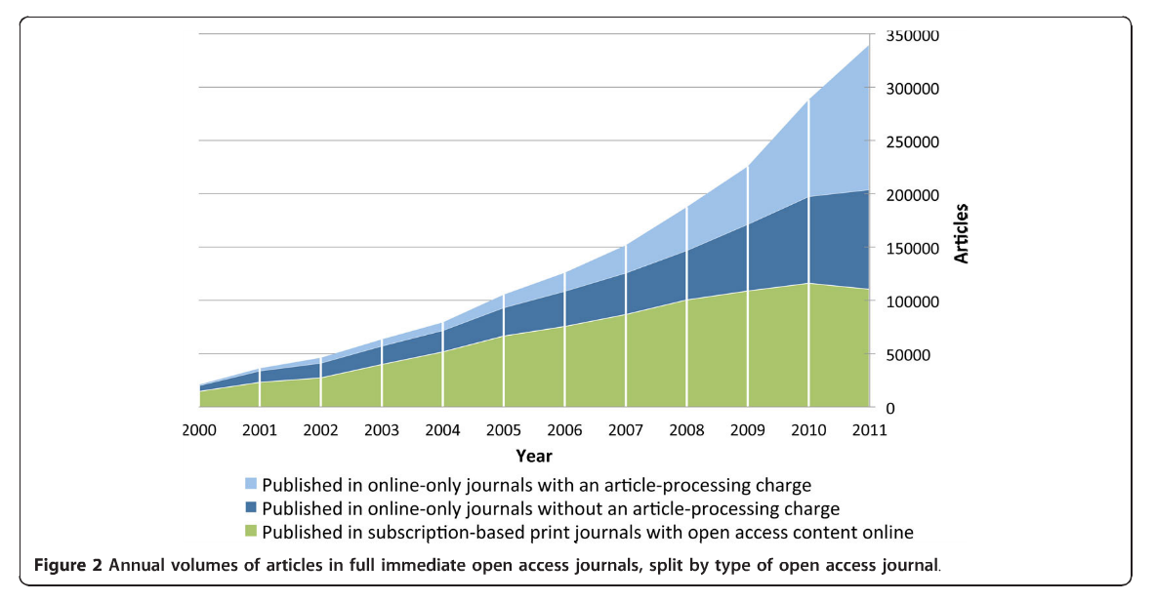
Laakso, M. & Björk, B.-C. Anatomy of open access publishing: a study of longitudinal development and internal structure. BMC medicine 10, 124 (2012).

Slide 7
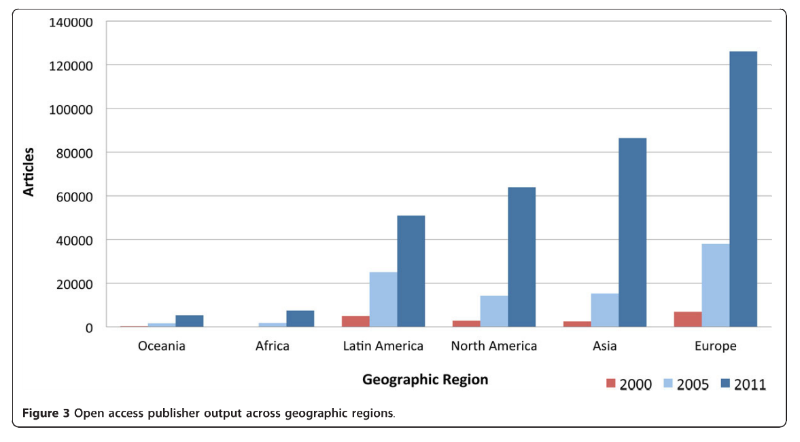
Laakso, M. & Björk, B.-C. Anatomy of open access publishing: a study of longitudinal development and internal structure. BMC medicine 10, 124 (2012).

Slide 8
Open Access @ NPG

Slide 9
OA @ NPG
NPG is actively expanding the open access options it offers to authors, with new open access journal launches and open access options on many subscription journals.
The first of these models were introduced in 2005, with the addition of open access options on 11 journals in 2009.
Further open access options on a number of journals were introduced in 2010 and 2011.
Currently, over sixty journals published by NPG offer open access options or are open access.
NPG published over 2000 open access articles in 2012.
http://www.nature.com/libraries/open_access/index.html

Slide 10


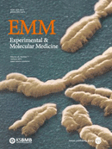
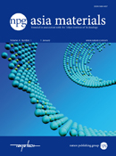
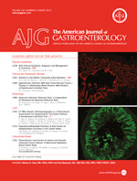
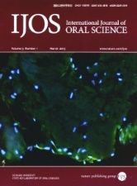
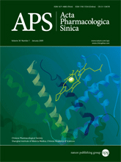
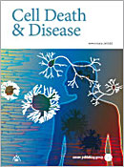

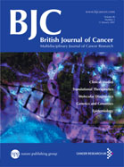
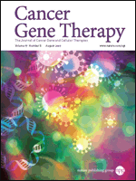
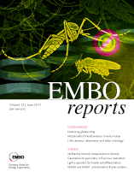
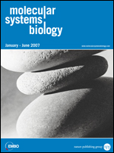


Slide 11


Slide 12


Slide 13
China is more active than Japan in OA publishing.

Slide 14

Article count (July 2013)
Japan
China

Slide 15
Article count with CC>=0.5 (July 2013)
Japan
China

Slide 16
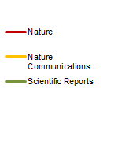
Article count (2013 extrapolated)
Japan
China

Slide 17
Authors in China and Japan are more receptive to OA publishing.

Slide 18
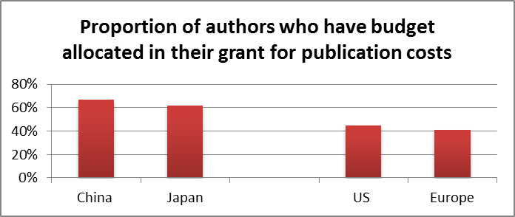
Nature Publishing Group surveys authors every year, and in January 2013 asked questions about OA activity and attitudes. NPG received over 23,000 responses to this survey, and respondents were comprised of a mix of authors published in NPG-journals and non-NPG journals alike.
Some clear differences emerged between authors based in China and Japan and those based in the US and Europe. Firstly, it was suspected that authors in China and Japan tended to have budget allocated within their grant for publication costs – this did indeed to be more common than in the US and Europe.

Slide 19
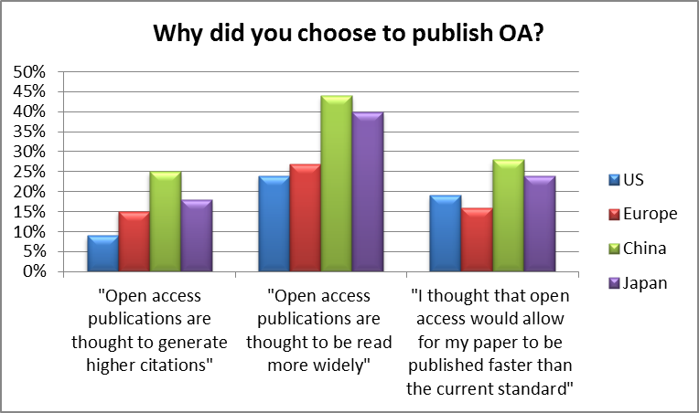
Those authors who had published under an OA model were asked why. Authors from China and Japan were much more likely to give ‘publishing’ reasons for choosing OA – believing that an OA paper would receive more citations, be read more widely and be published faster.

Slide 20
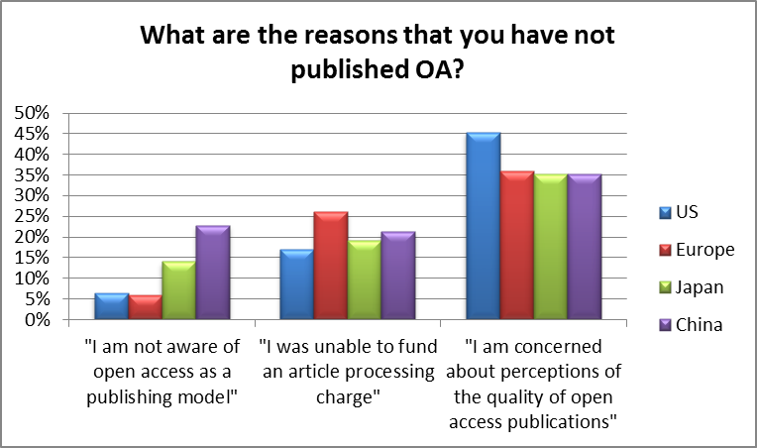
Those authors who had not published OA were asked why not. It is apparent that awareness of OA is much greater in the US and Europe, and that concerns about perceptions of quality seemed to be highest in the US.

Slide 21
There is stronger support in the scientific community and more funds available for OA in Asia despite lack of government mandates.
This translates to unusually high numbers of OA papers in Nature Communications and Scientific Reports from Japan and in particular China.
Frustrations over lack of visibility of Asian research in the West and a belief that OA will increase visibility may be driving Asian (Japan and China) scientists to publish OA with more determination than their Western colleagues.

Slide 22
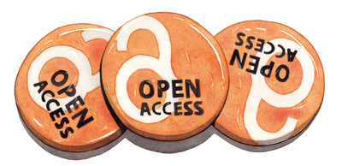
thanks

