Slide 1
Evolution, Revolution, transfiguration
(Something wonderful is about to happen)
Philip E. Schreur
Stanford University Libraries
European BIBFRAME Workshop
September 17, 2018

Slide 2

EVOLUTION

Slide 3

Evolution – First Steps

Slide 4
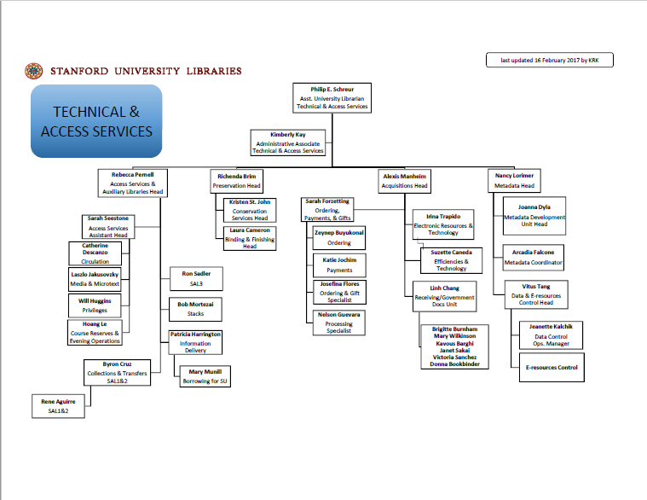
Evolution – First Steps

Slide 5
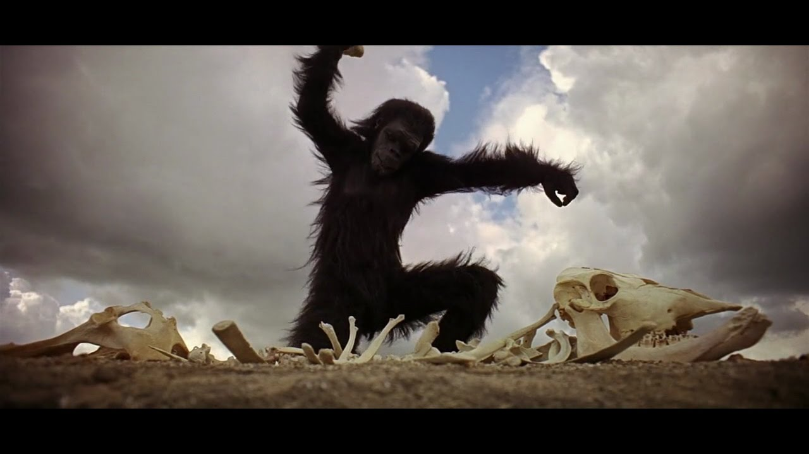
Evolution – Acquisitions Department

Slide 6
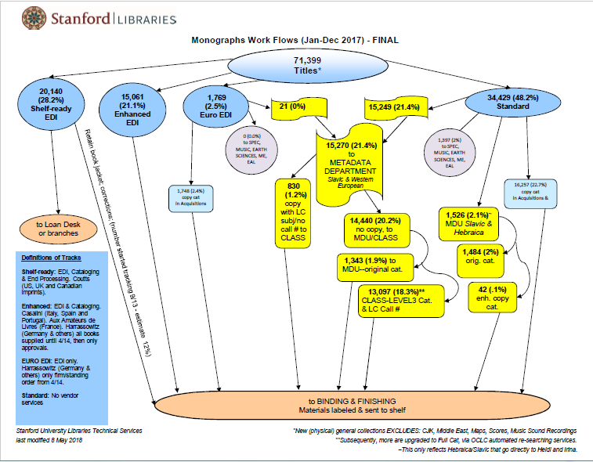
Evolution – Acquisitions Department

Slide 7

Evolution/Acquisitions = Efficiency

Slide 8
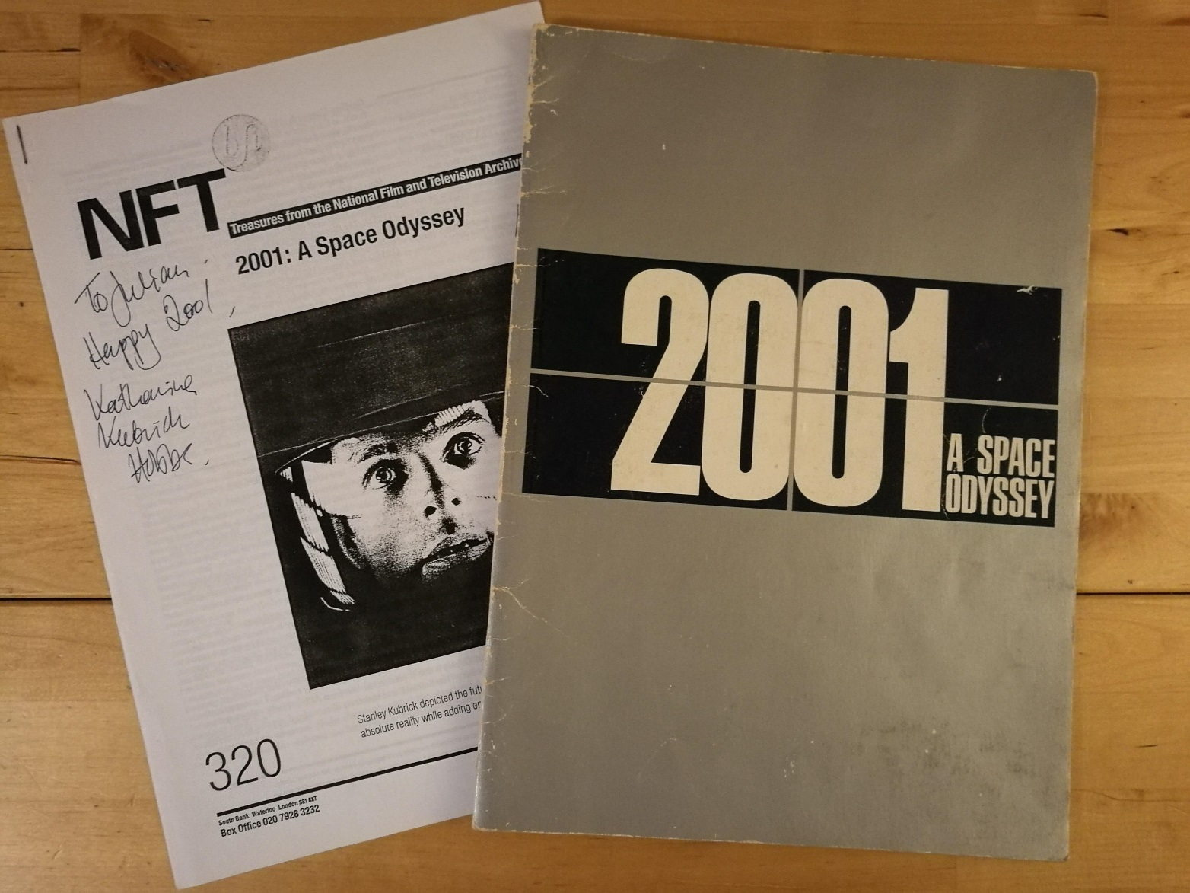
Evolution/Acquisitions = Reports

Slide 9
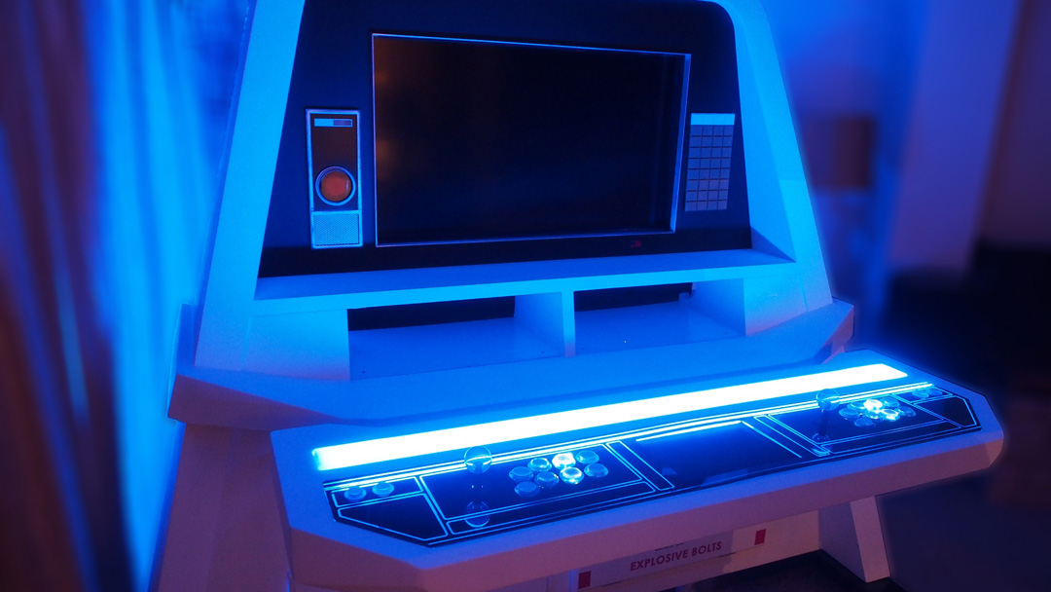
Evolution – Metadata Department
https://creativemess.net/2001-space-odyssey-themed-arcade-cabinet/

Slide 10

Evolution/Metadata Department = Pathways
https://filmmakermagazine.com/105557-christopher-nolans-unrestored-70mm-2001-a-space-odyssey-at-the-village-east/

Slide 11
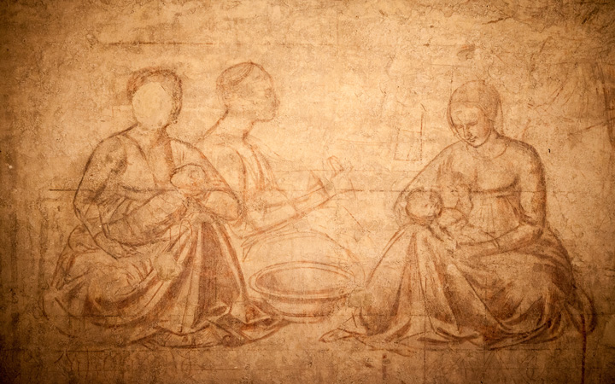
Evolution/Metadata Department = Sinopia
https://www.opapisa.it/en/square-of-miracles/sinopie-museum/

Slide 12
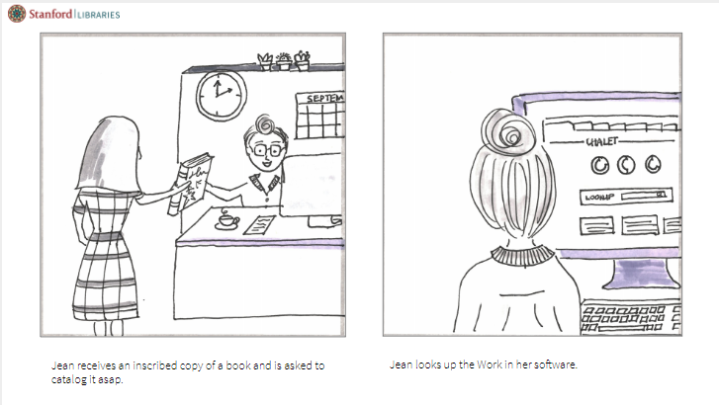
Evolution/Metadata Department = Sinopia

Slide 13
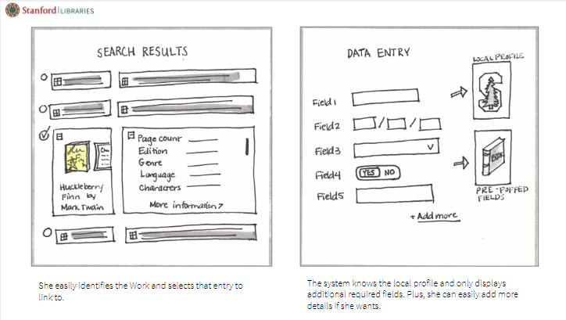
Evolution/Catalog Department = Sinopia

Slide 14
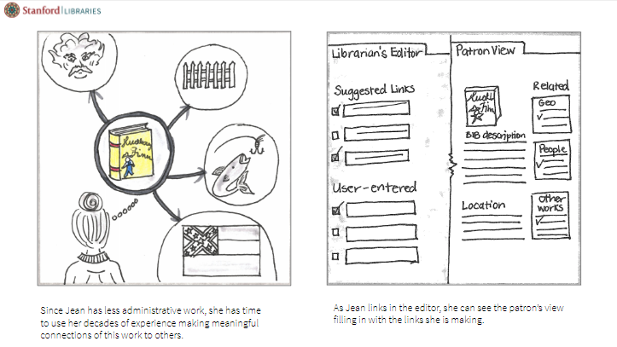
Evolution/Metadata Department = Sinopia

Slide 15
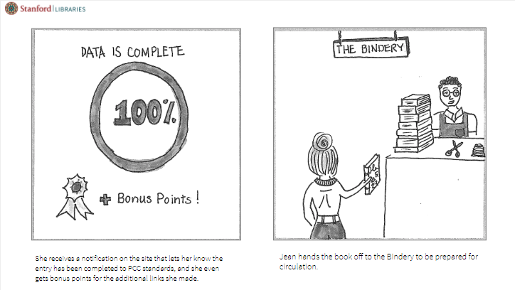
Evolution/Metadata Department = Sinopia

Slide 16
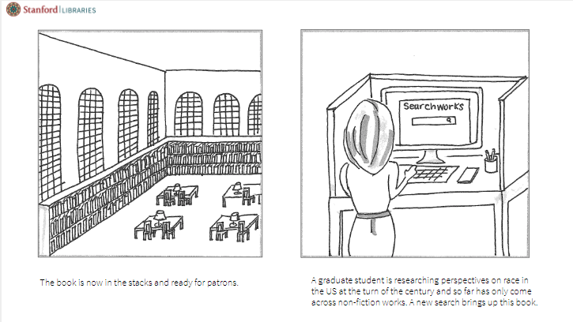
Evolution/Metadata Department = Sinopia

Slide 17
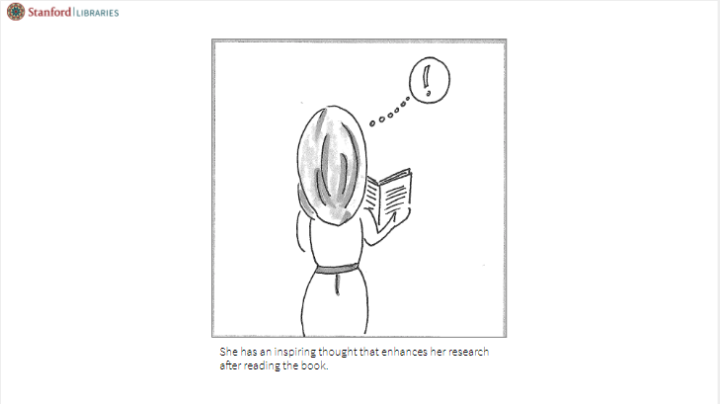
Evolution/Metadata Department = Sinopia

Slide 18
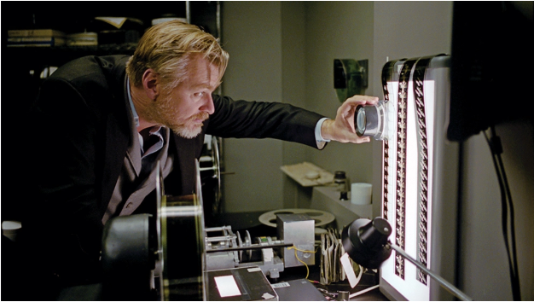
Evolution – Preservation Department
https://variety.com/2018/artisans/production/christopher-nolan-2001-a-space-odyssey-1202811669/

Slide 19

REVOLUTION

Slide 20
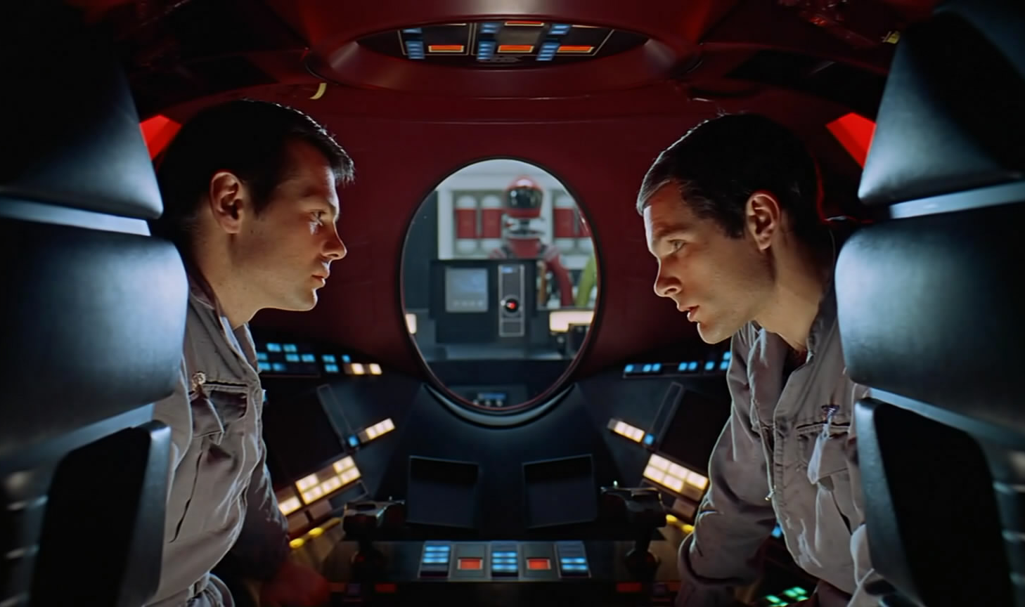
Revolution – Staff Development & Training

Slide 21
Revolution – Job Descriptions
2006
2018
Responsible for original cataloging of monographs in humanities in Western European languages at the appropriate level. Serves as a resource person for Spanish language.
Performs original cataloging of humanities monographs in a variety of Western European languages according to AACR2 cataloging rules or other metadata standards and local departmental policies and procedures at the BIBCO or other appropriate level.
Using traditional cataloging standards as well as existing and emerging metadata schemas, and techniques such as linked data, supports creation, organization, and maintenance of metadata to facilitate search, discovery, and access to resources in various formats.
Creates discovery metadata for Humanities materials applying the metadata schema appropriate to the material as defined by policy. Currently, predominate schema is RDA applied according to the BIBCO standards, but others such as MODS applied as needed.
Collaborates with team members to evaluate, select, and apply metadata schemas and techniques, standards, data elements, and thesauri to provide description and access to SUL collections.

Slide 22
Revolution – New Positions
Linked Data Technologist
Metadata Strategist
Responsible for the transformtion of multiple data formats into RDF (including the manipulation of the metadata for successful ingestion), maintenance of the resultant datastore, and development of tools and services to accomplish these goals in support of SUL's linked data environment
Ensure the harmonization of descriptive metadata standards across SUL for resources deposited to the SDR to maximize discovery in a shared discovery environment(s)
Proactively engage with DLSS Project Managers in establishing appropriate approaches (both manual and automated) for the creation of descriptive metadata for individual projects
Develop policies and procedures in support of the harmonization goals and broker acceptance of mutually agreed upon descriptive metadata standards across relevant stakeholders in SUL

Slide 23

Revolution – Humanizing Linked Data

Slide 24

Revolution – HumanizingLinked Data

Slide 25
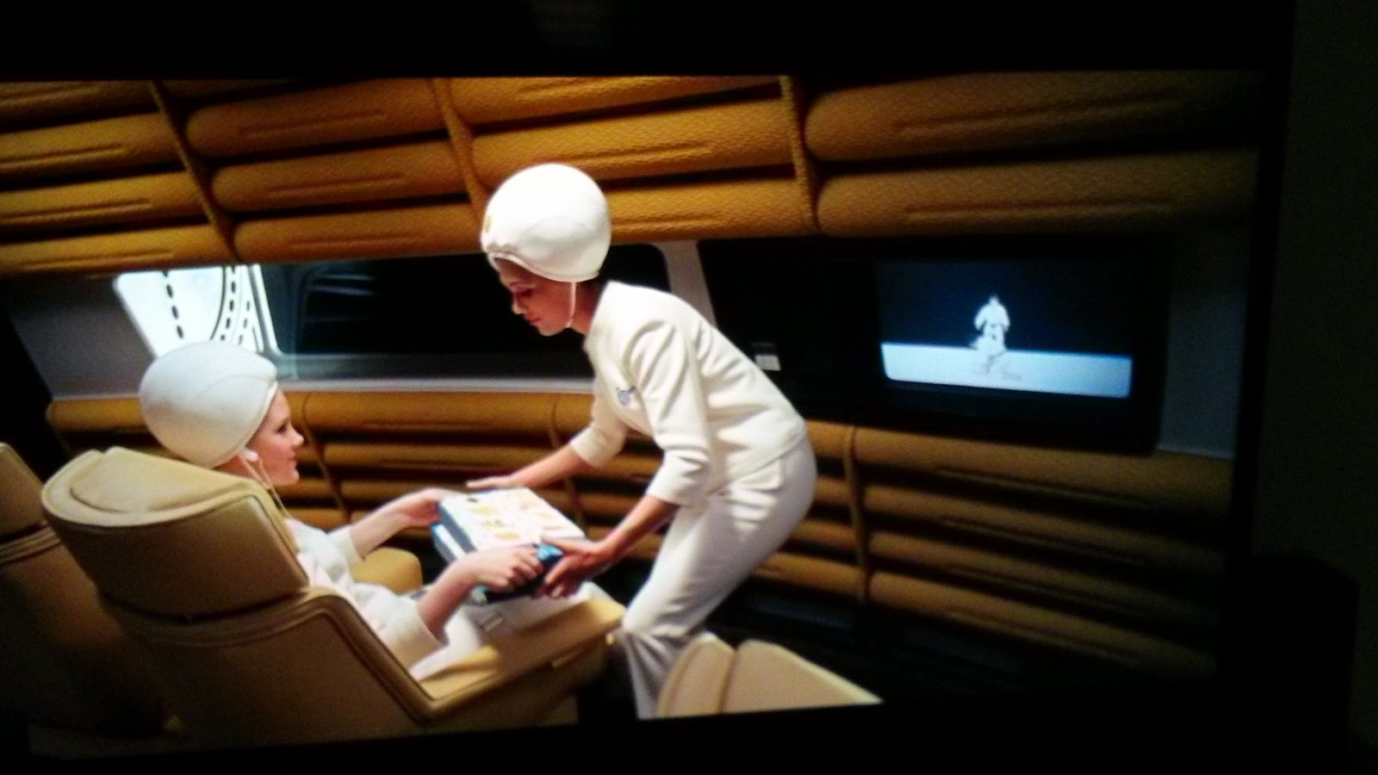
Revolution/Linked Data = Data Sharing
http://www.infrics.com/2014/09/how-2001-space-odyssey-got-future-right.html

Slide 26
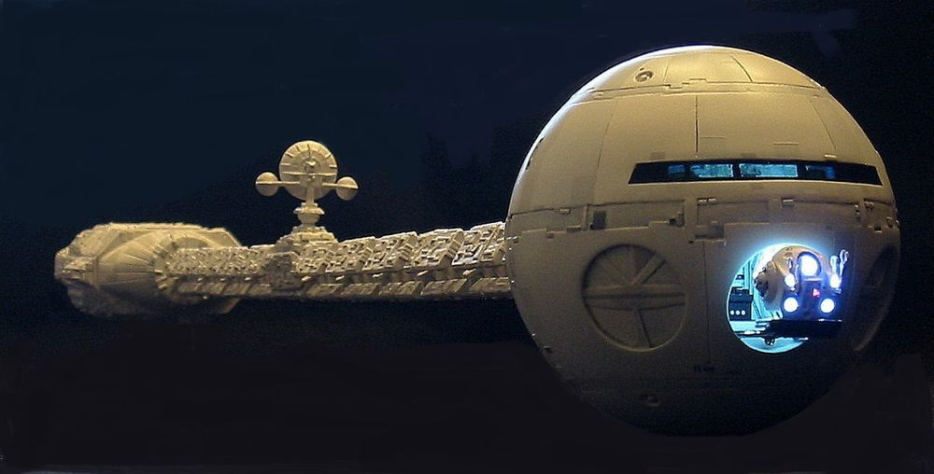
Revolution/Linked Data = Discovery
https://www.pinterest.com/pin/486670303463057324/

Slide 27

TRANSFIGURATION

Slide 28

Transfiguration – What’s out there?

Slide 29

Transfiguration – Something Wonderful!

